Slide 1
Neuroplasticity, CNS Transmitters, Brain and Ageing

Slide 2
Learning outcomes
Explain the cellular and molecular mechanisms underpinning neuroplasticity and synaptic adaptation.
Discuss the role of key CNS neurotransmitters in modulating motor and cognitive function.
Analyse how ageing influences neural plasticity, neurotransmission, and motor learning capacity.
Describe the principles of neuroplasticity to design rehabilitation strategies for clients with neurological impairments across the lifespan.

Slide 3
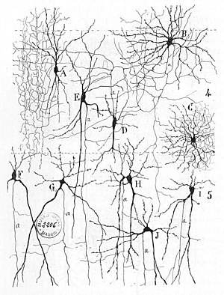
Cellular excitability and plasticity

Slide 4

Excitability
The ability of cells to change their membrane potential in response to stimuli
  Voltage, ligands, light, mechanical stimulation
Not just neurons
  Muscle cells, endocrine cells, cochlear hair cells, rods and cones in the retina
Expression of voltage- and/or ligand-gated ion channels
  Change in membrane potential trigger a conformational change which opens a pore
  Permeability to ions (Na⁺, Ca²⁺, K⁺, Cl⁻)

Slide 5
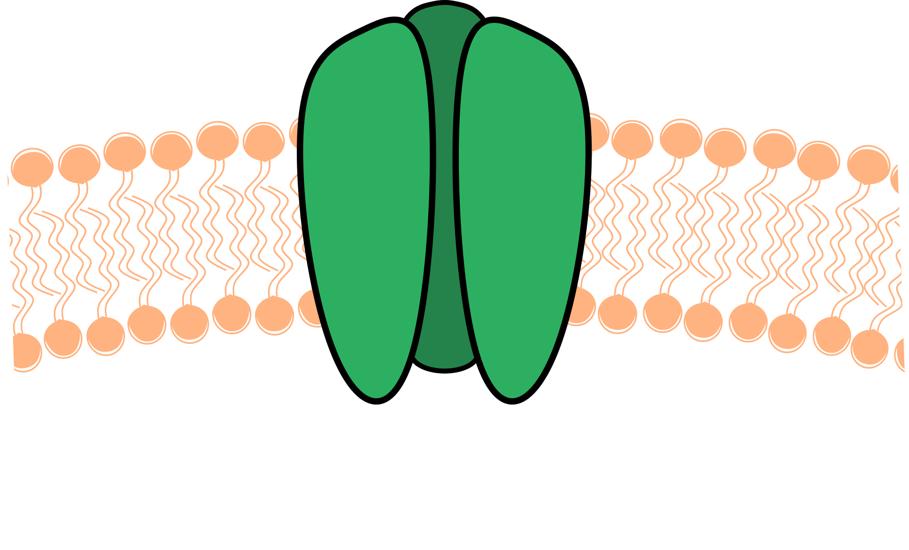
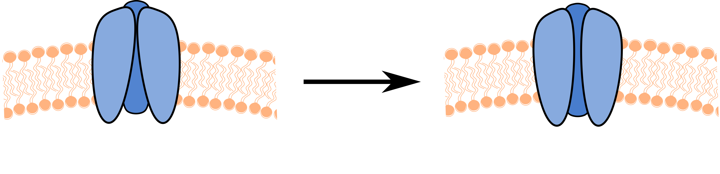
Ion channels
Transmembrane proteins
  Mono or multimeric
  Extracellular and intracellular domains
  Opening (pore)
Selective permeability (pore)
  Specific ions (Na⁺, K⁺, Ca²⁺, Cl⁻)
  Groups of ions (cations, anions)
Voltage-gated ion channels activate when reaching specific voltages
  Voltage sensors trigger
  conformational changes
Constantly open (leak)
Gated
Contribute to the resting membrane potential
Open in response to stimuli
Closed
Open
Voltage
Ligands
Light
Conformational
change

Slide 6
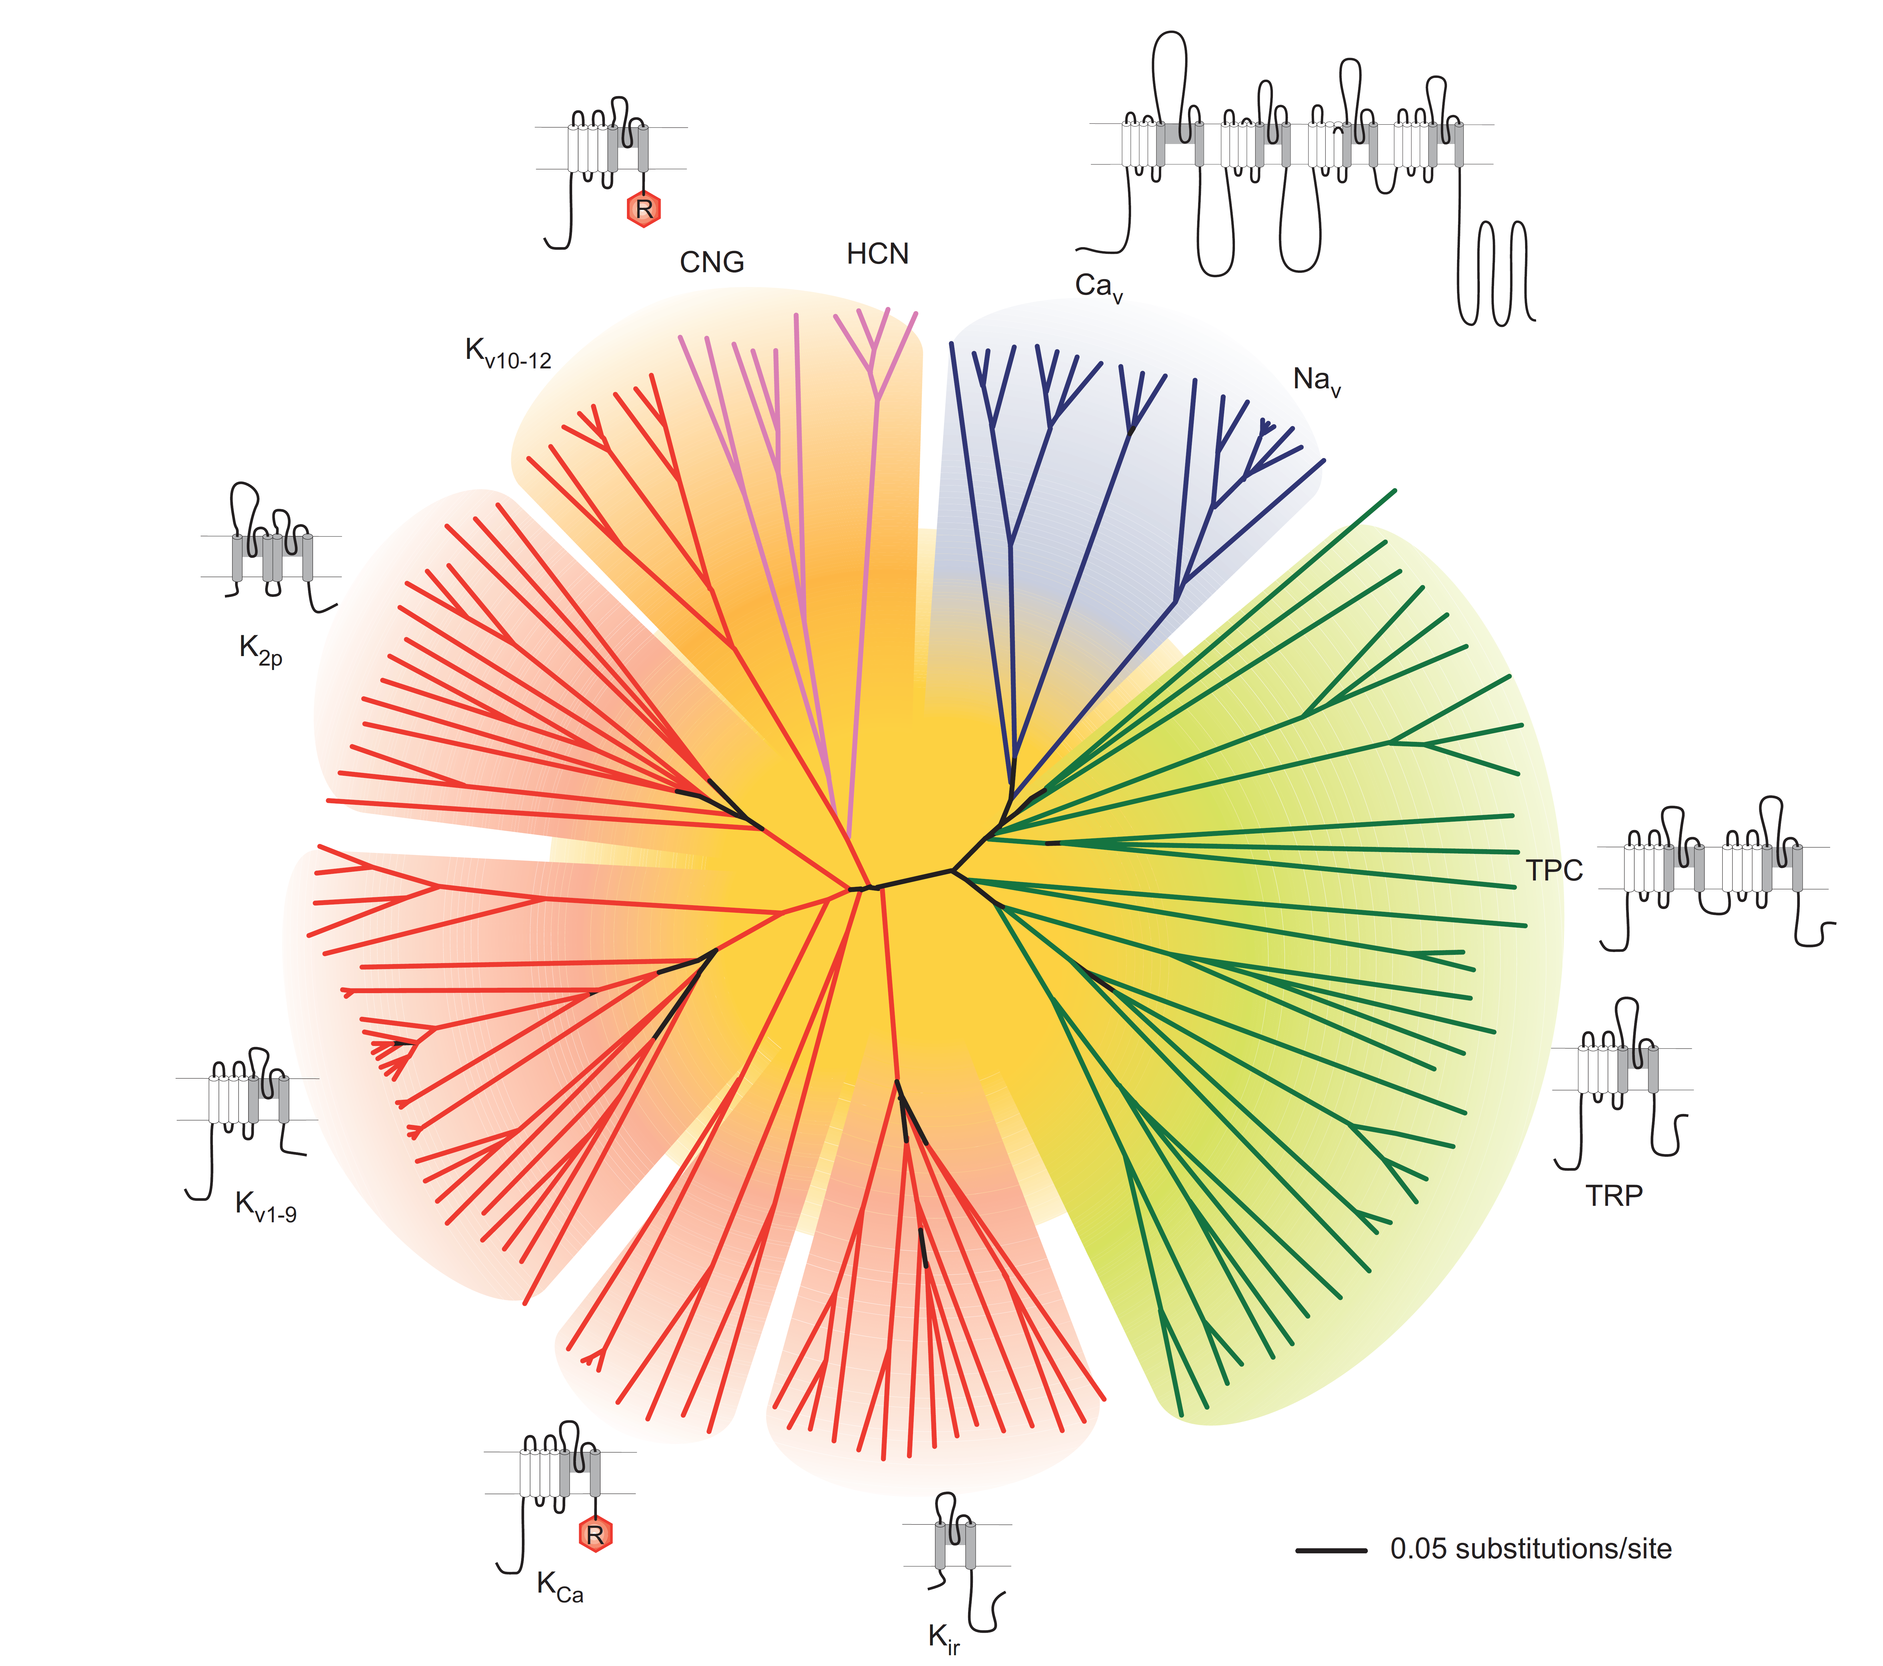
Ion channels families

Slide 7
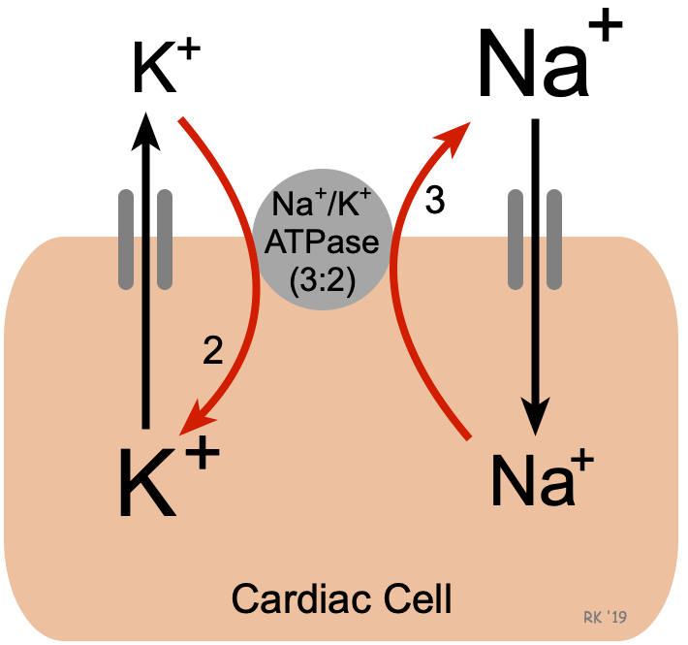
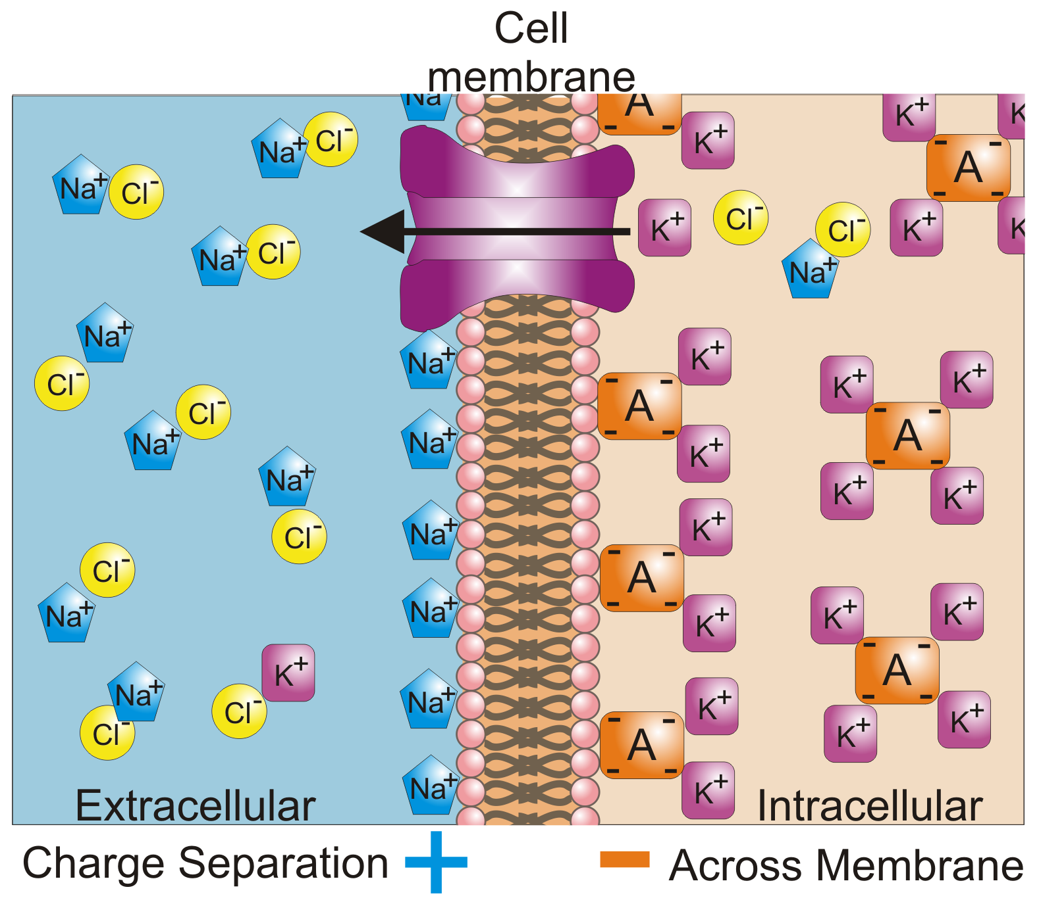
Resting membrane potential (voltage)
Na⁺/K⁺ ATPase keeps high extracellular Na⁺ and high intracellular K⁺
Imbalance of charges along the membrane
  Intracellular side of the membrane has a many negatively charged molecules (proteins, lipids, etc)
  Extracellular side of the membrane has many Na⁺ cations → Positive charge
  Ions can hardly pass through the membrane
High Na⁺
High K⁺
Extracellular
Intracellular

Slide 8
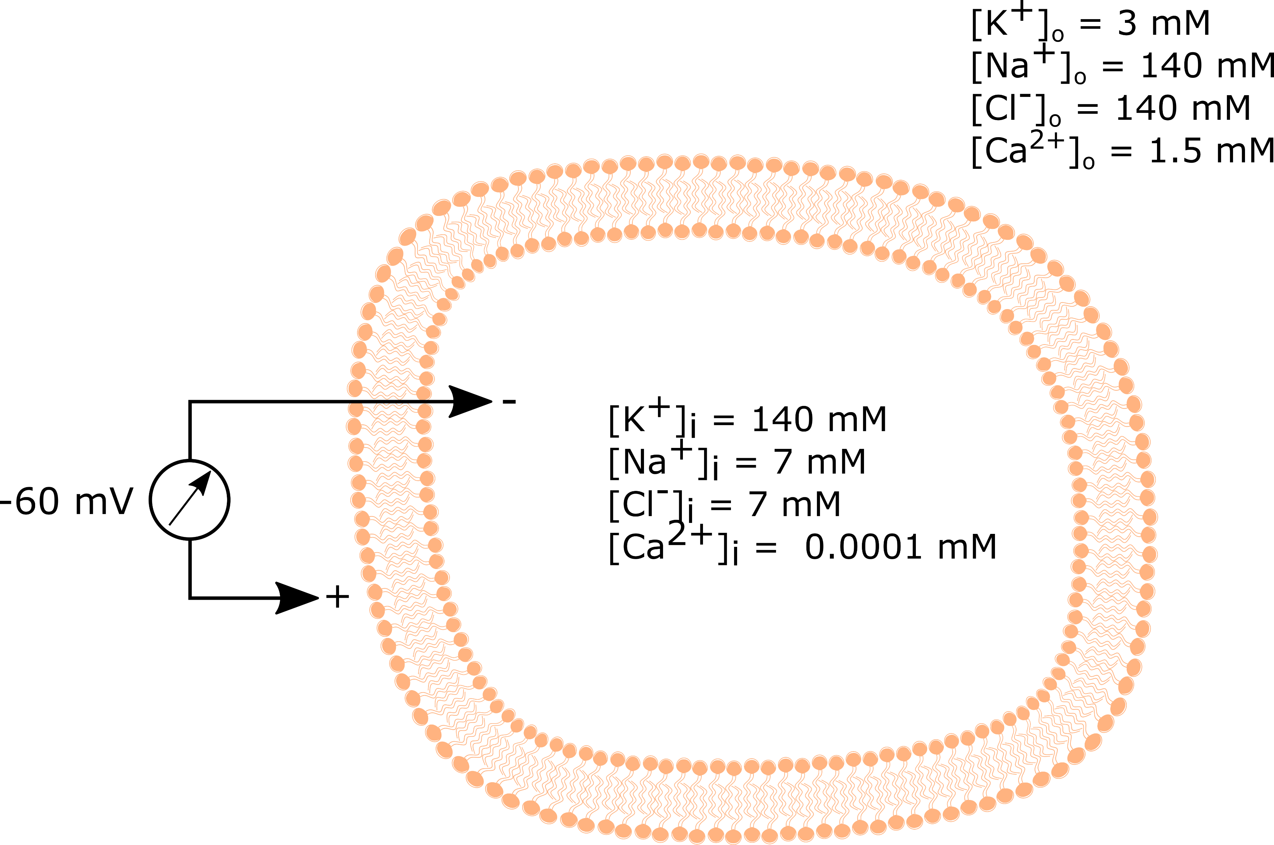
Resting membrane potential (voltage)
Ions will try to move according to the electrochemical gradient
  Chemical concentration of ions
  Imbalance in + and – charges along the membrane (electric potential)
Ion channels let ions pass according to the membrane potential
K⁺
Na⁺
Ca²⁺
Cl⁻
The cell uses the electrochemical gradient to activate rapid mechanisms/signals
The resting membrane potential is the battery of the cell!

Slide 9
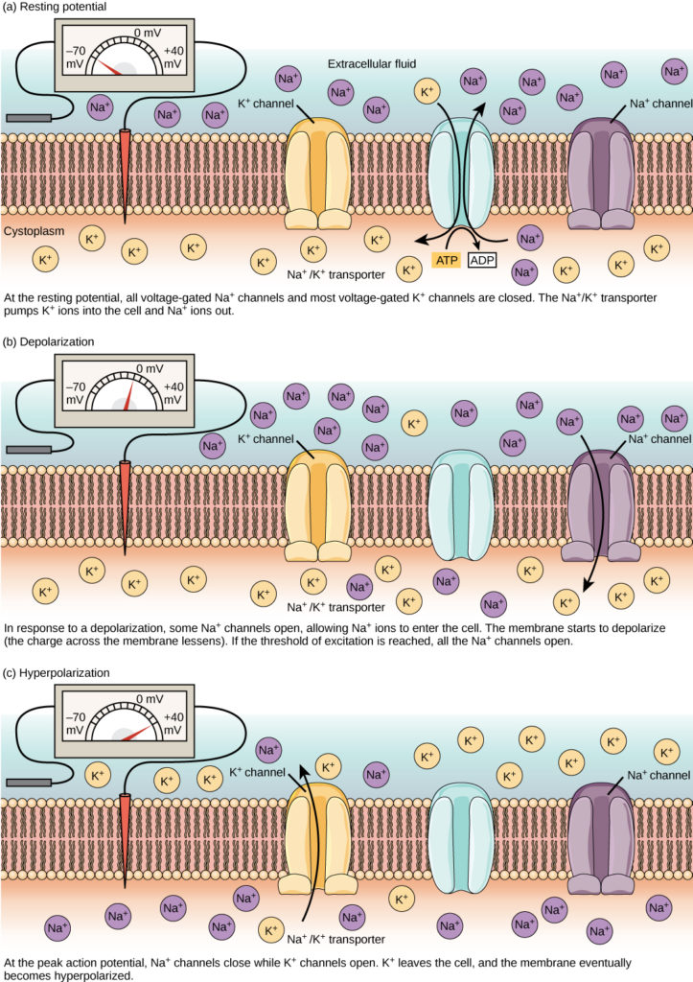
Action potential
At resting membrane potential
  Na⁺ and K⁺ channels are closed
Stimuli positively increase the membrane potential (voltage) (depolarization)
Upon reaching a voltage threshold, Na⁺ channels open
  Massive flow of Na⁺ ions inside the cell depolarizes even more the membrane potential
Further depolarization opens K⁺ channels
  Flow of K⁺ ions outside the cell reduces negatively the membrane potential (repolarization + hyperpolarization)
https://courses.lumenlearning.com/wm-biology2/chapter/resting-membrane-potential/

Slide 10
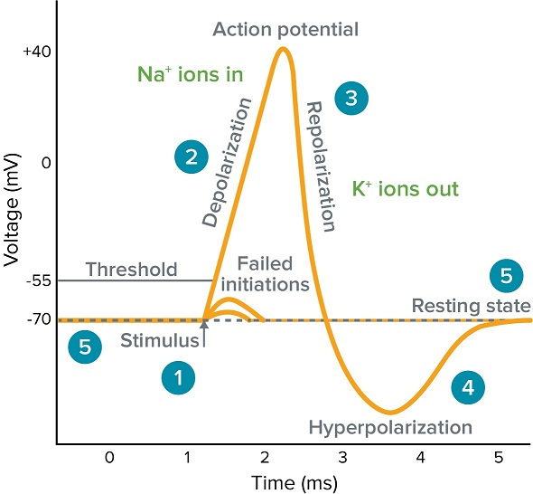
Action potential
At resting membrane potential
  Na⁺ and K⁺ channels are closed
Stimuli positively increase the membrane potential (voltage) (depolarization)
Upon reaching a voltage threshold, Na⁺ channels open
  Massive flow of Na⁺ ions inside the cell depolarizes even more the membrane potential
Further depolarization opens K⁺ channels
  Flow of K⁺ ions outside the cell reduces negatively the membrane potential (repolarization + hyperpolarization )
5
1
2
3
4
https://www.moleculardevices.com/applications/patch-clamp-electrophysiology/what-action-potential#gref

Slide 11
The refractory period
Na⁺ channels inactivate (absolute refractory period)
  No following action potential can be initiated
K⁺ channels are open (relative refractory period)
  Very strong stimuli can initiate an action potential
https://www.moleculardevices.com/applications/patch-clamp-electrophysiology/what-action-potential#gref

Slide 12
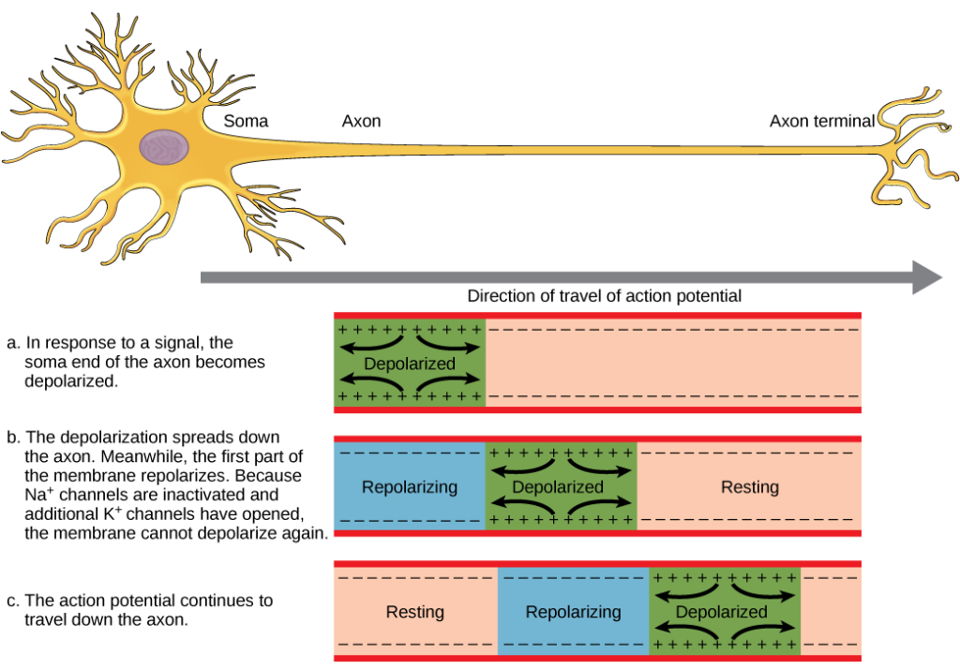
AP conduction and refractory period

Slide 13
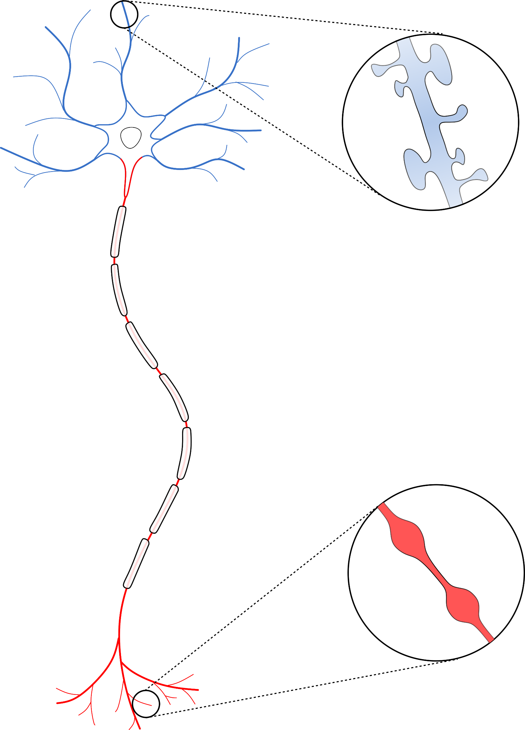
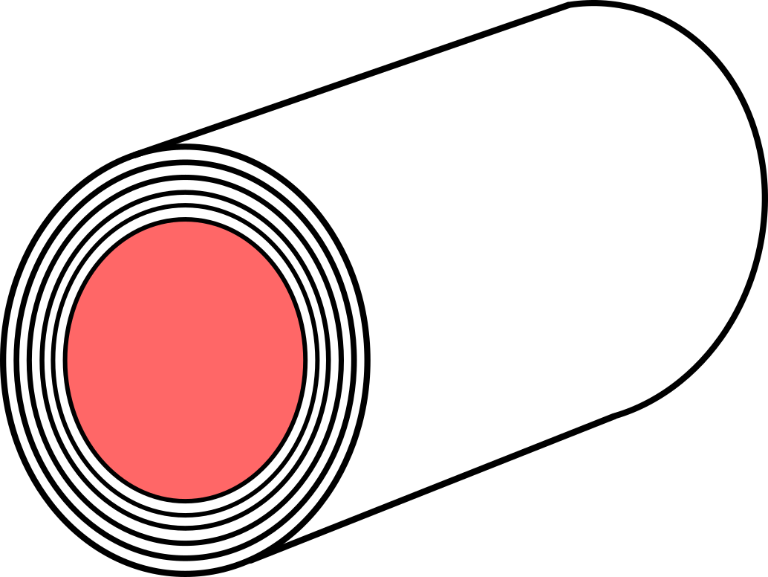
The neuron
Ability to process multiple inputs into an output
Specialized morphology
  Multitude of inputs → Dendrites
  Output → Axon
  Input neuron or target neuron can be very distant (projecting)
Excitable
  Voltage-/Ligand-gated ion channels
  Fast conduction of signals (myelin)
Axon
Initial Segment (AIS)
Dendritic
Spines
Nodes of
Ranvier
Myelin sheaths
Axonal Boutons
Terminals

Slide 14
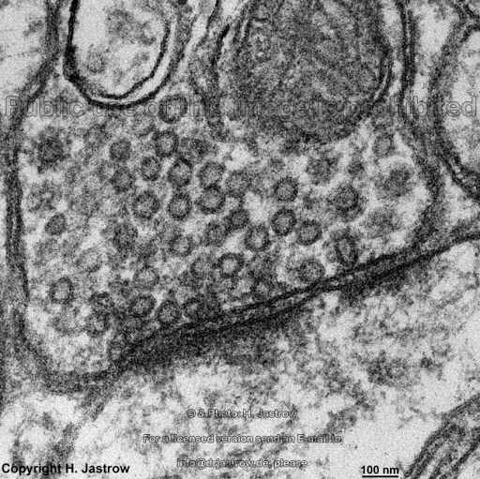
Neuronal output: the bouton
Boutons
Majority of neuronal connections (synapses) are chemical
  The signal is released by the bouton in small messenger molecules → Neurotransmitters
Neurotransmitters are contained in synaptic vesicles
  The vesicles fuse with the membrane, releasing the neurotransmitters into the synaptic cleft
  The release machinery fuses the vesicles and needs Ca²⁺ channels to work
  The identity (neuronal type) of the neuron is defined by the neurotransmitter
Synaptic
vesicles

Slide 15
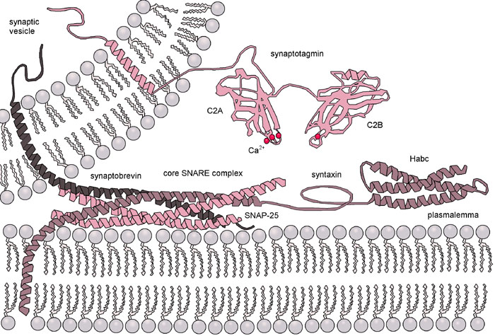
Neuronal output: the bouton
SNARE proteins in the release machinery forces the vesicle and the plasma membrane against each other, inducing their Ca²⁺-dependent fusion

Slide 16

The neurotransmitter
Main inhibitory
neurotransmitter
Main excitatory
neurotransmitter
https://www.compoundchem.com/2015/07/30/neurotransmitters/

Slide 17
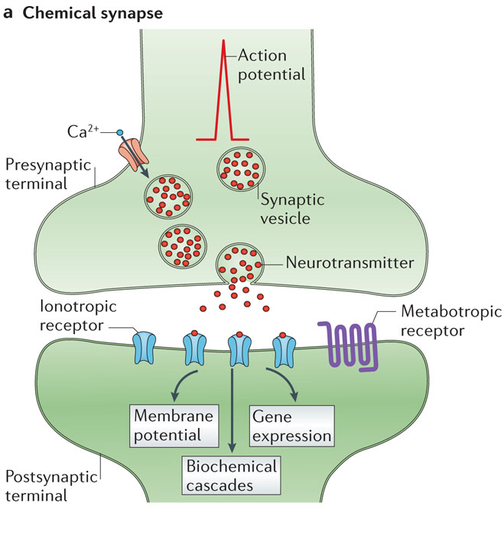
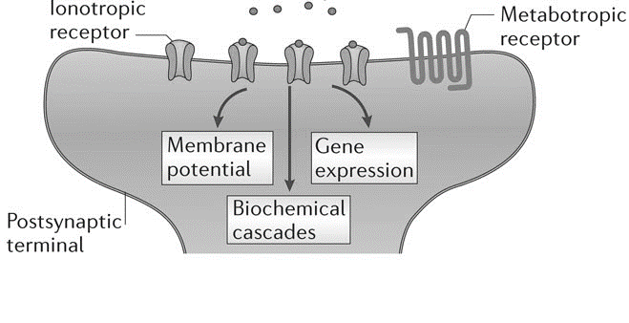
The synapse
Boutons are the presynaptic components of the synapse
  Neurotransmitters are released in the synaptic cleft
Dendritic spines are the postsynaptic components of the synapse
  The neurotransmitters bind to ligand-gated ion channels and metabotropic receptors
Synaptic
cleft
Dendritic
spines
Nature Reviews Neuroscience volume15, pages 250–263 (2014)

Slide 18
The Postsynaptic Density
Ion channels (ionotropic)
  NMDARs, AMPARs, KainateR
  GABA_{A} receptors
  Voltage-gated ion channels (Ca²⁺, K⁺, Na⁺)
GPCRs/TKRs
  Catecholamine receptors (Dopamine, Noradrenaline)
  Serotonin Receptors
  Glutamate metabotropic receptors
  GABA_{B} metabotropic receptors
  TrKB/BDNF
Transporters
Kinases/phosphatases
  CaMKII
  PKA
  PKC
  Src
  ERK
  PDEs
  PP-1
Adaptor proteins
  PSD-95/PSD-93
  Homer
  Shank
Cytoskeleton proteins
Synaptic
cleft
Postsynaptic density (PSD)
Nature Reviews Neuroscience volume15, pages 250–263 (2014)

Slide 19
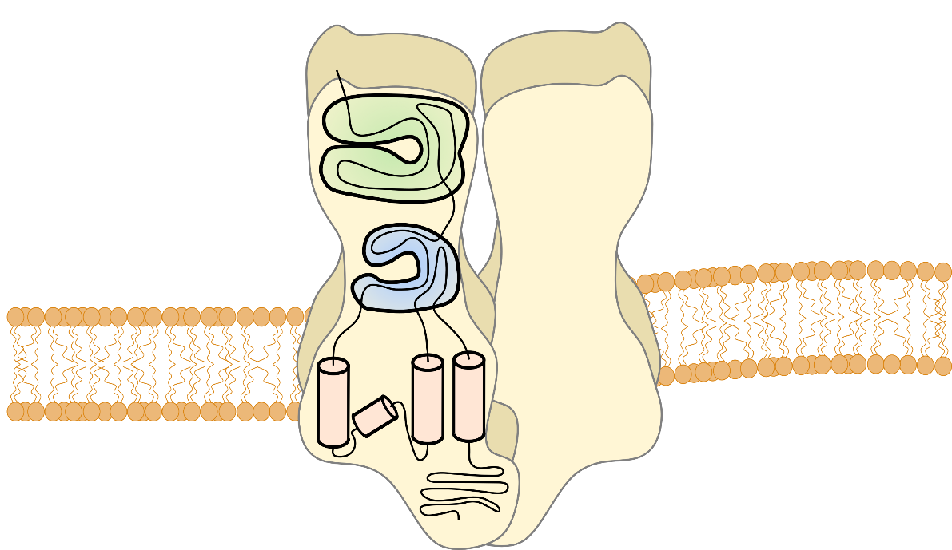
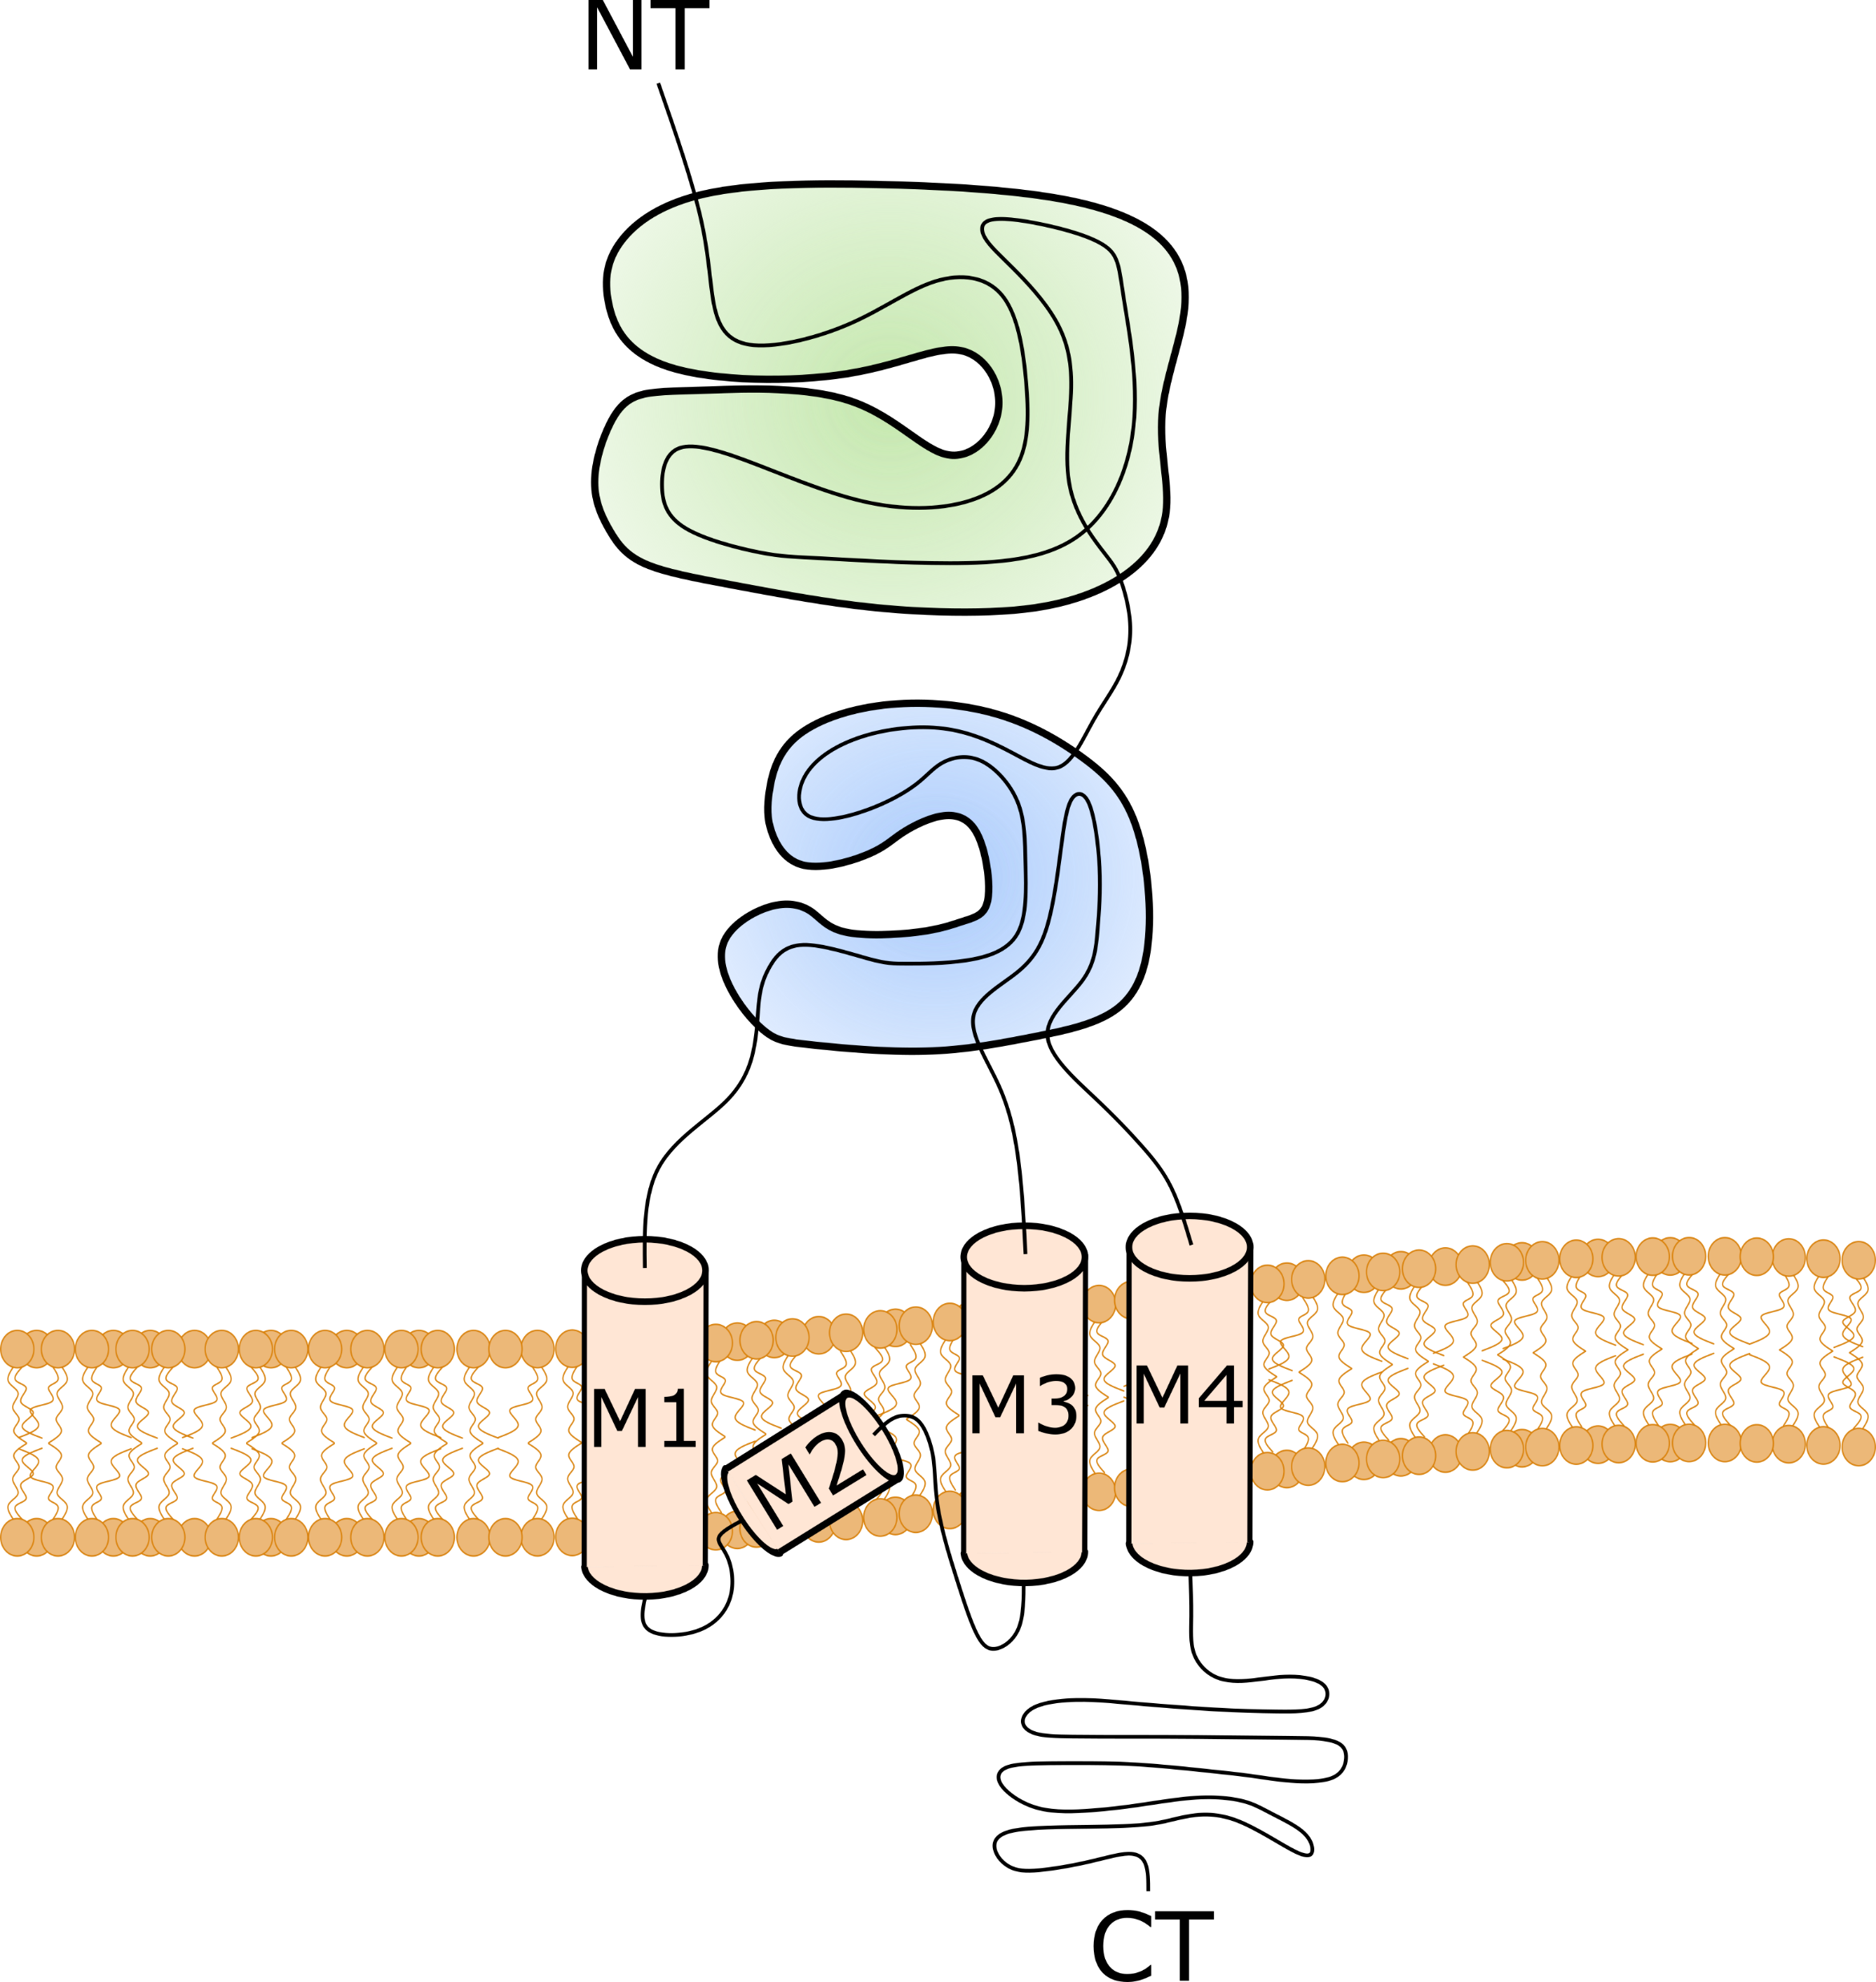
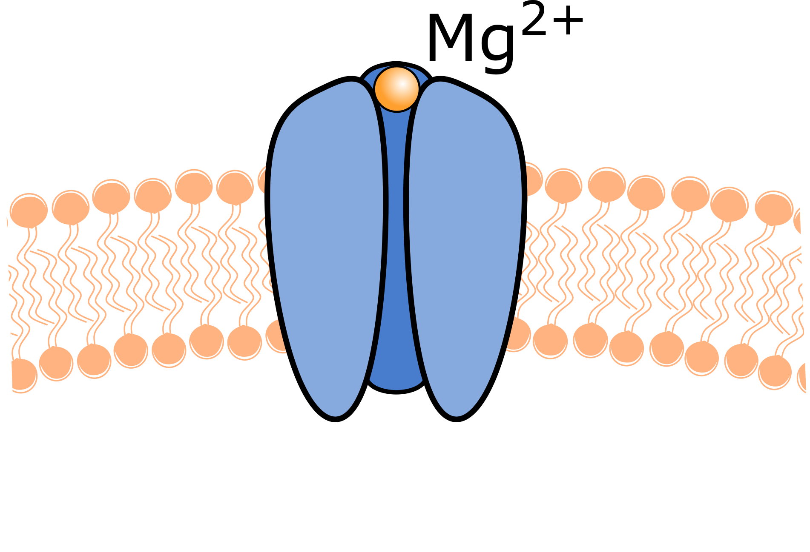
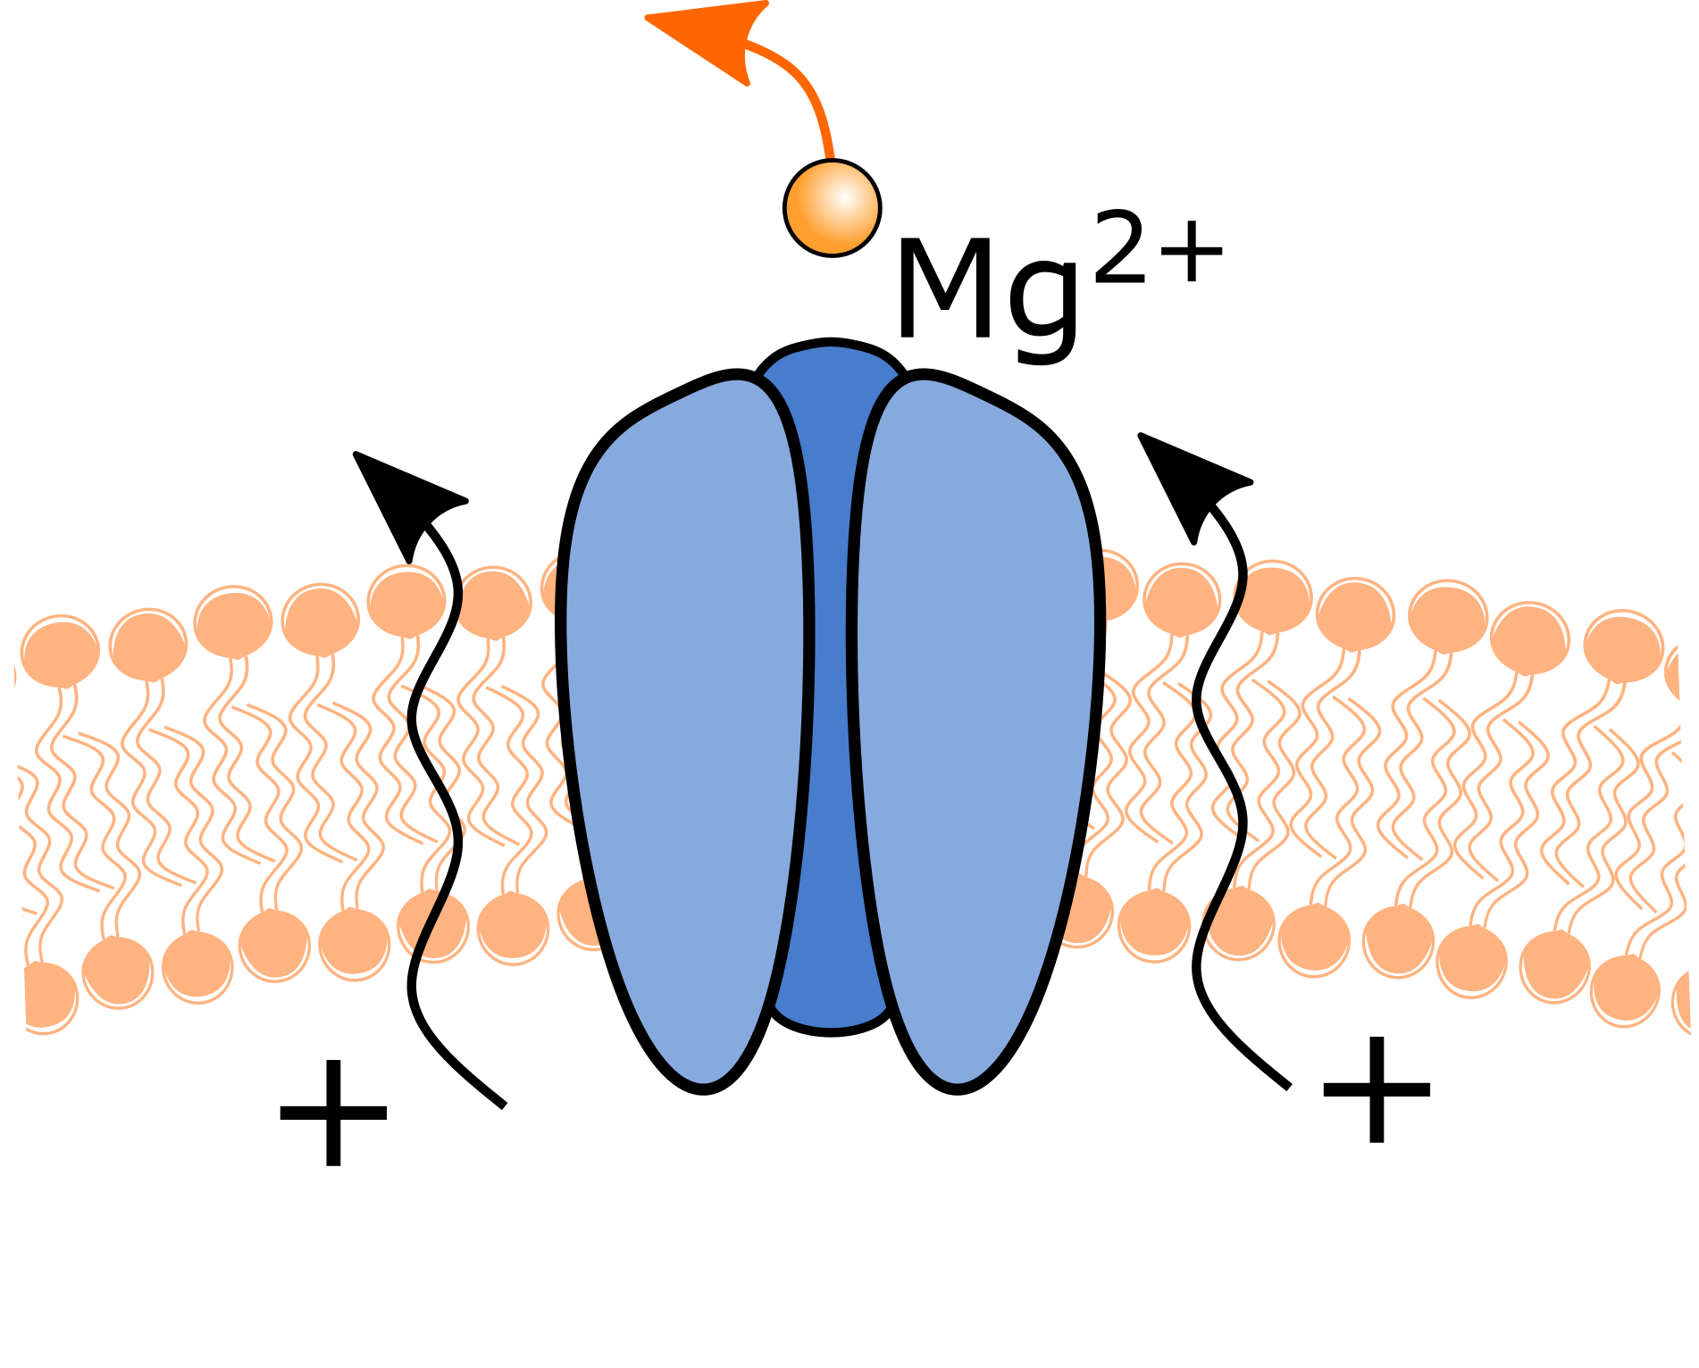
Ionotropic glutamate receptors
Ligand-gated ion channels
3 main types:
  AMPA receptors
  NMDA receptors
  Kainate receptors
All form heterotetramers
AMPAR permeable to Na⁺, K⁺ and, in some cases, Ca²⁺
NMDAR permeable to Ca²⁺
  Only permeable during depolarization! → Mg²⁺ block
ATD
LBD
S1
S2
NMDAR
Depolarization
CTD
P-loop
NMDAR

Slide 20
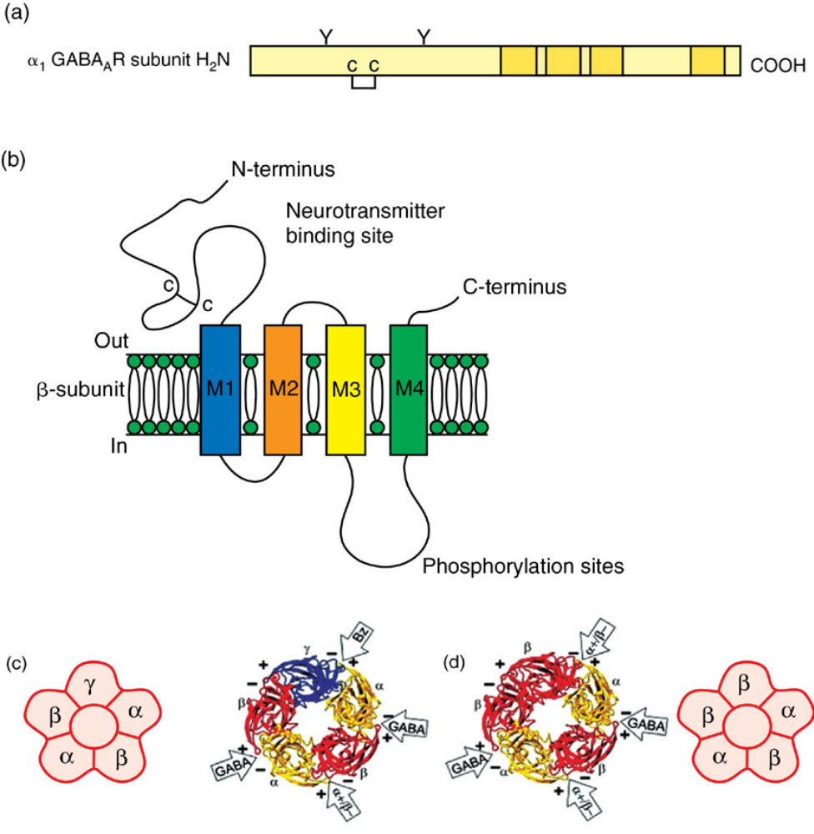
Ionotropic GABA_{A} receptors
Permeable to Cl⁻
Binds γ-aminobutyric acid (GABA)
  Bind to benzodiazepines and barbiturates
GABA_{A}R is a pentamer
  Major form with 2 α1, 2 β2, 1 γ2 (αβαβγ)

Slide 21
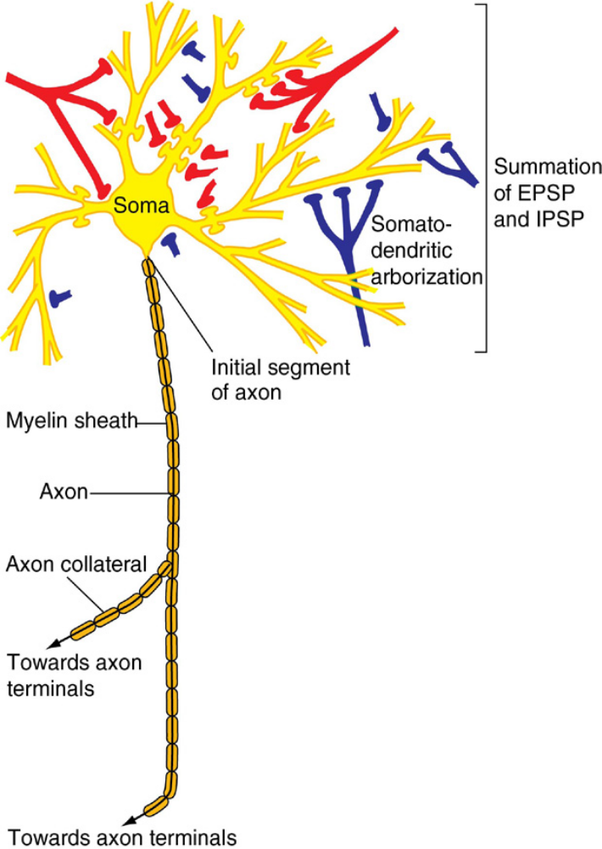
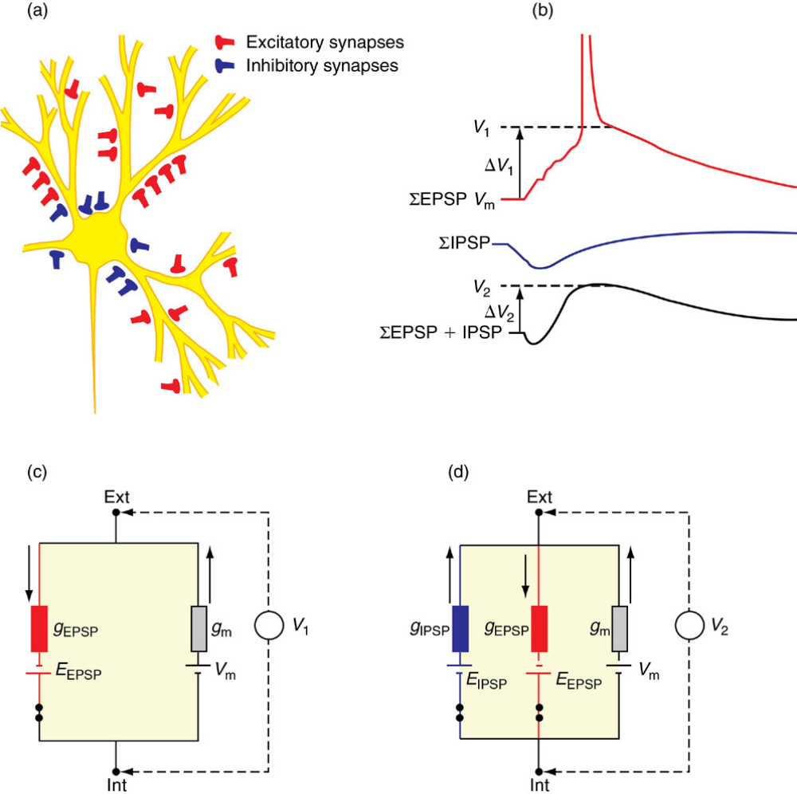
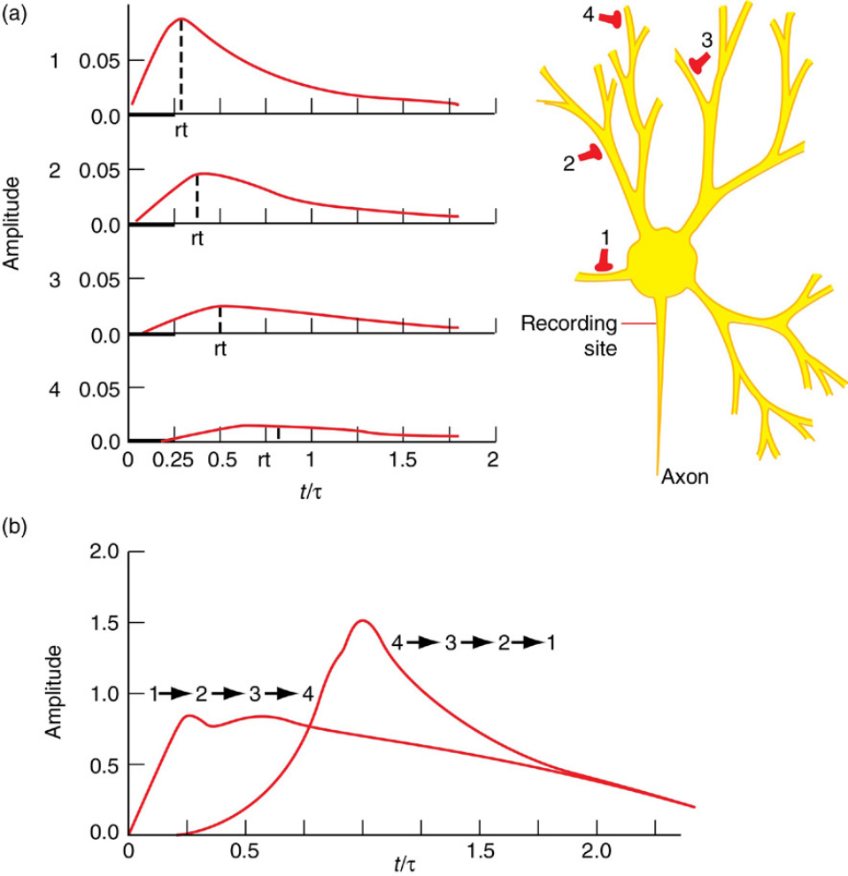
Neuronal signal integration
Each neuron receives numerous inputs
  Axo-dendritic
  Axo-somatic
  Axo-axonic (AIS and terminals)
When a synapse is activated, it will either generate:
  Excitatory Post-Synaptic Potential (EPSP)
  Inhibitory Post-Synaptic Potential (IPSP)
The summation of EPSPs and IPSPs will determine the level of depolarization reaching the soma

Slide 22
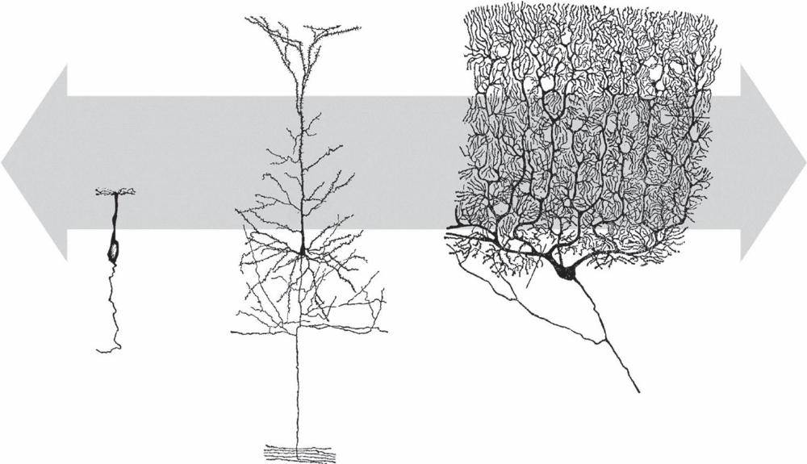
Specific Dendritic Morphology
The structure of the dendritic arbour varies based on neuronal tissue and types/number of inputs
Selective
Selective
Multilayered
Wide
Olfactory Cell
Purkinje Cell
Pyramidal Cell
Greg Stuart, Nelson Spruston, Michael Häusser
Dendrites (2016, Oxford University Press)

Slide 23
Neuronal networks
In the CNS 2 main types of neurons:
  Excitatory neurons - principal cells
  Inhibitory neurons - interneurons
In cortex and hippocampus
  Principal cells are the pyramidal cells (glutamatergic)
  Interneuron (GABAergic) types can be many (parvalbumin, somatostatin, etc)

Slide 24
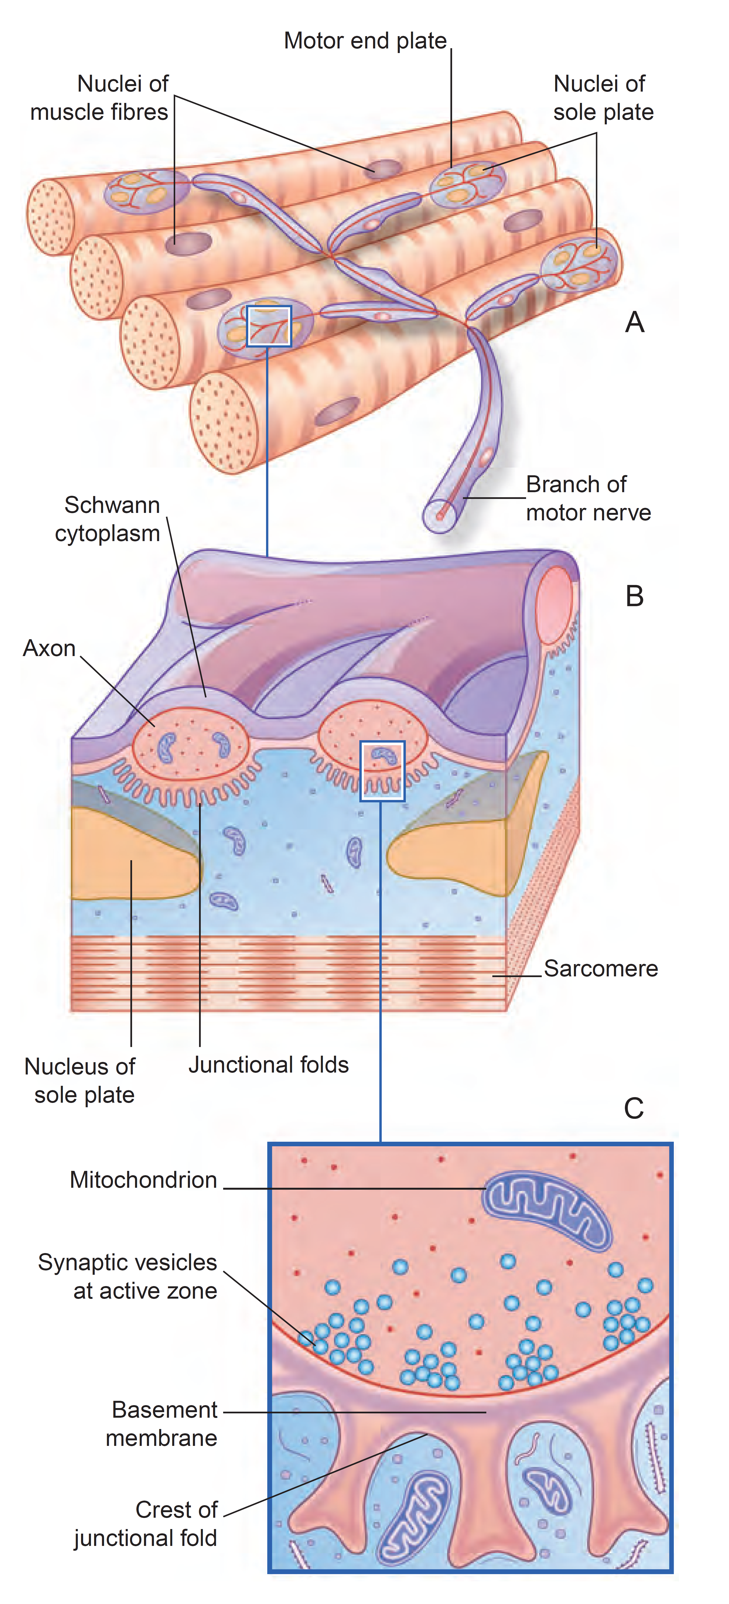
The neuromuscular junction
Motor neurons axonal terminals highly branch onto the muscle to form neuromuscular junctions (NMJ)
NMJ are rich in nicotinic receptors, which recognize acetylcholine
Nicotinic receptors opening allows Na⁺ and Ca⁺ to and depolarization of the muscle cell

Slide 25
Synaptic Plasticity
Synaptic strength can change with time
  Frequency and kinetics of synaptic inputs
  Synaptic morphology, pre-synaptic properties and post-synaptic proteins
Short-term plasticity
  Often pre-synaptic
  Lasts seconds to minutes
Long-term plasticity
  Often post-synaptic
  Lasts for minutes, hours or even days
Synaptic strength can change in both directons:
  Potentiation - when synapses become stronger
  Depression - when synapses become weaker
Synaptic
cleft
PSD
Nature Reviews Neuroscience volume15, pages 250–263 (2014)

Slide 26
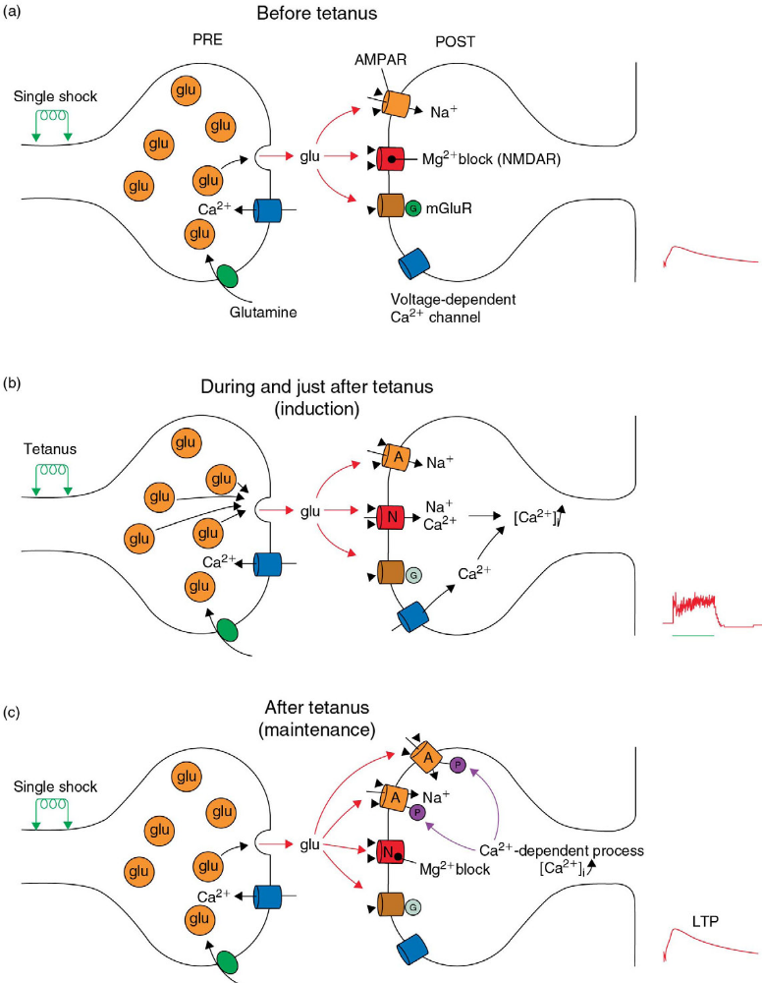
Long-term potentiation (LTP)
The frequency of EPSPs can increase synaptic strength
Constance Hammond – Cellular and Molecular Neurophysiology 4th ed (2015)

Slide 27
Long-term potentiation (LTP)
The frequency of EPSPs can increase synaptic strength
Constance Hammond – Cellular and Molecular Neurophysiology 4th ed (2015)

Slide 28
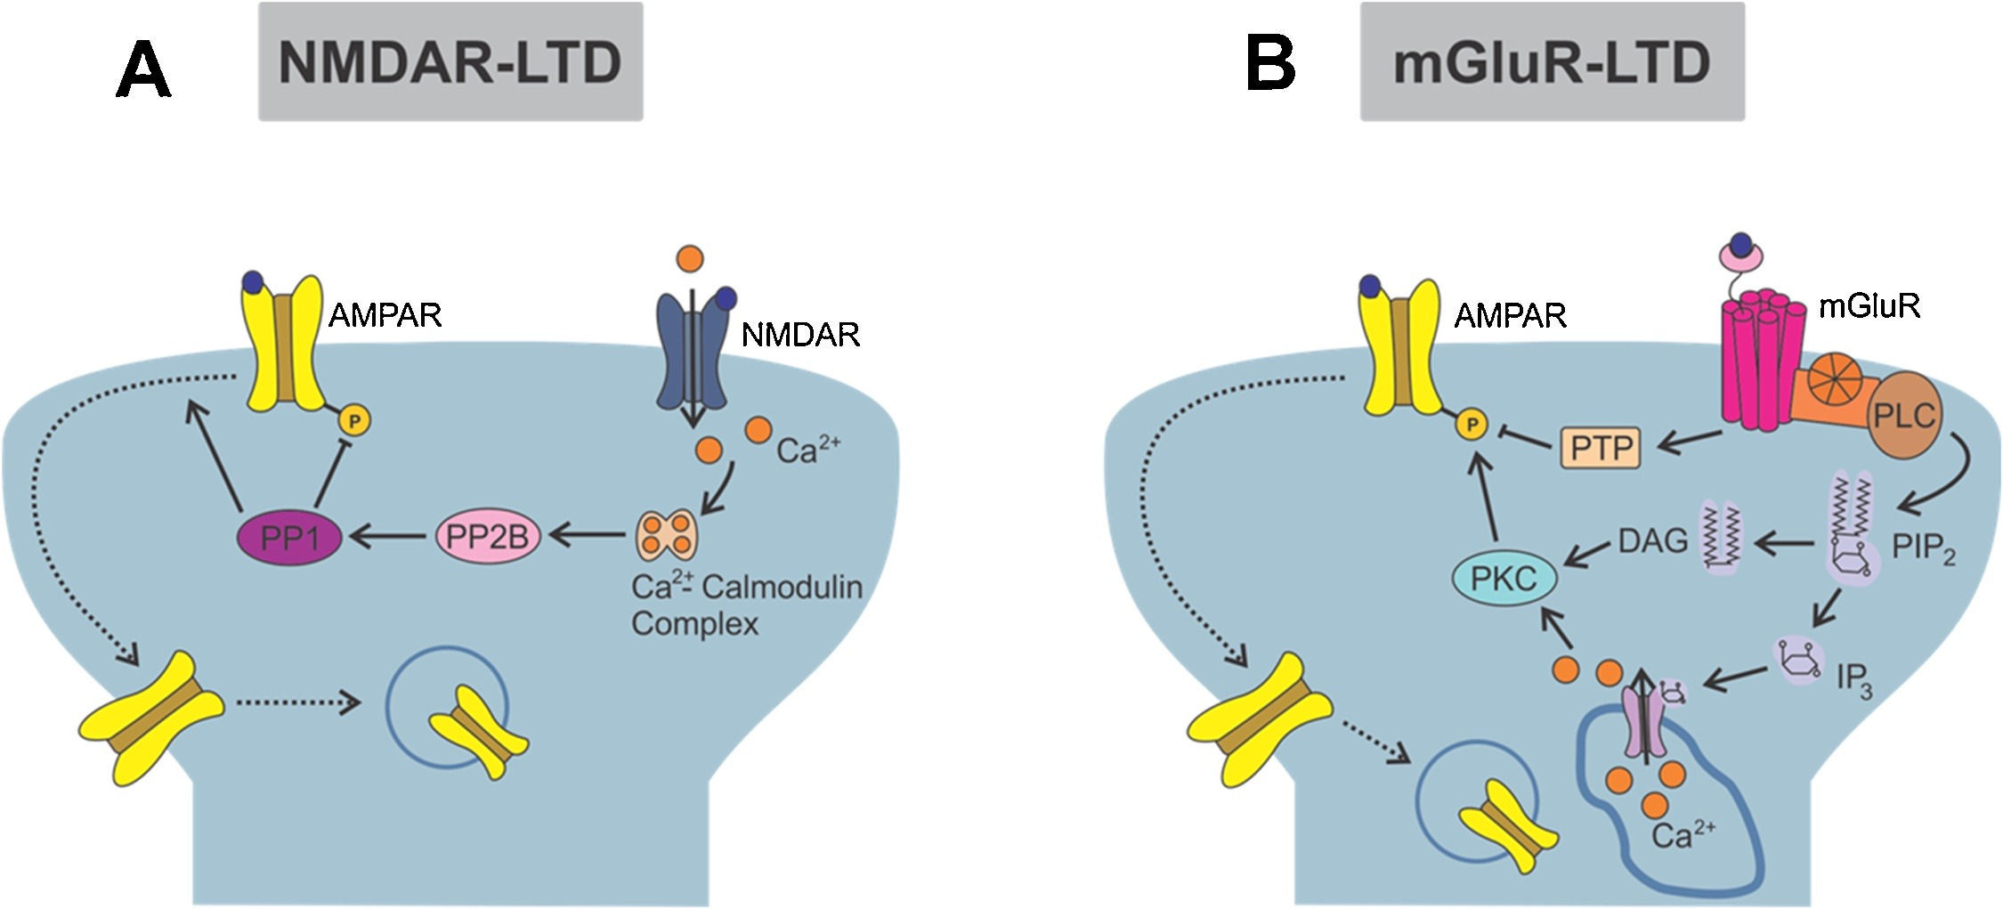
Long-term depression (LTD)
A range of low frequency of inputs or activation of specific metabotropic receptors can reduce synaptic strength

Slide 29
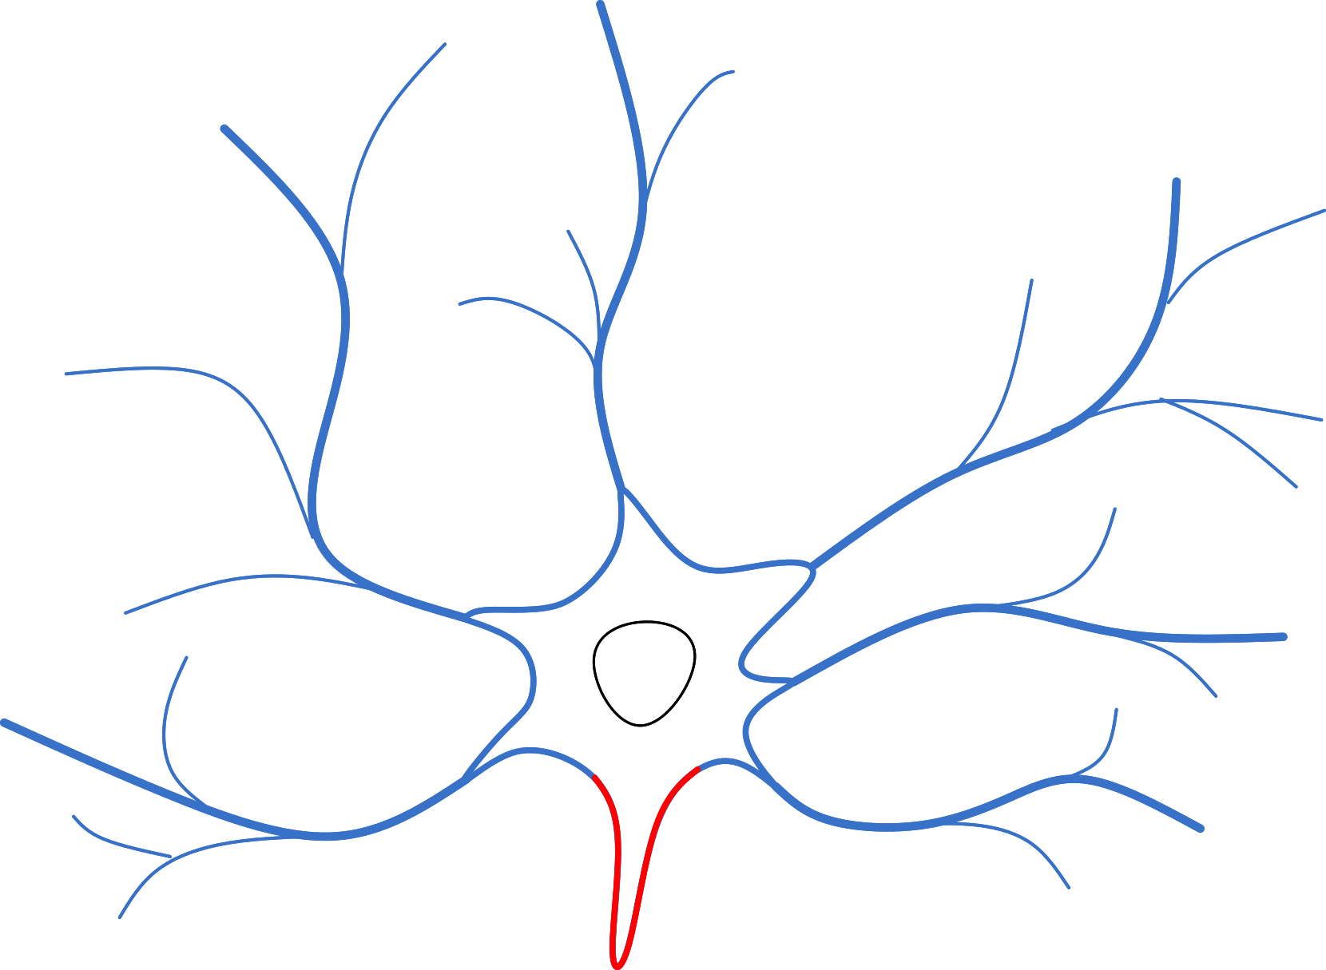
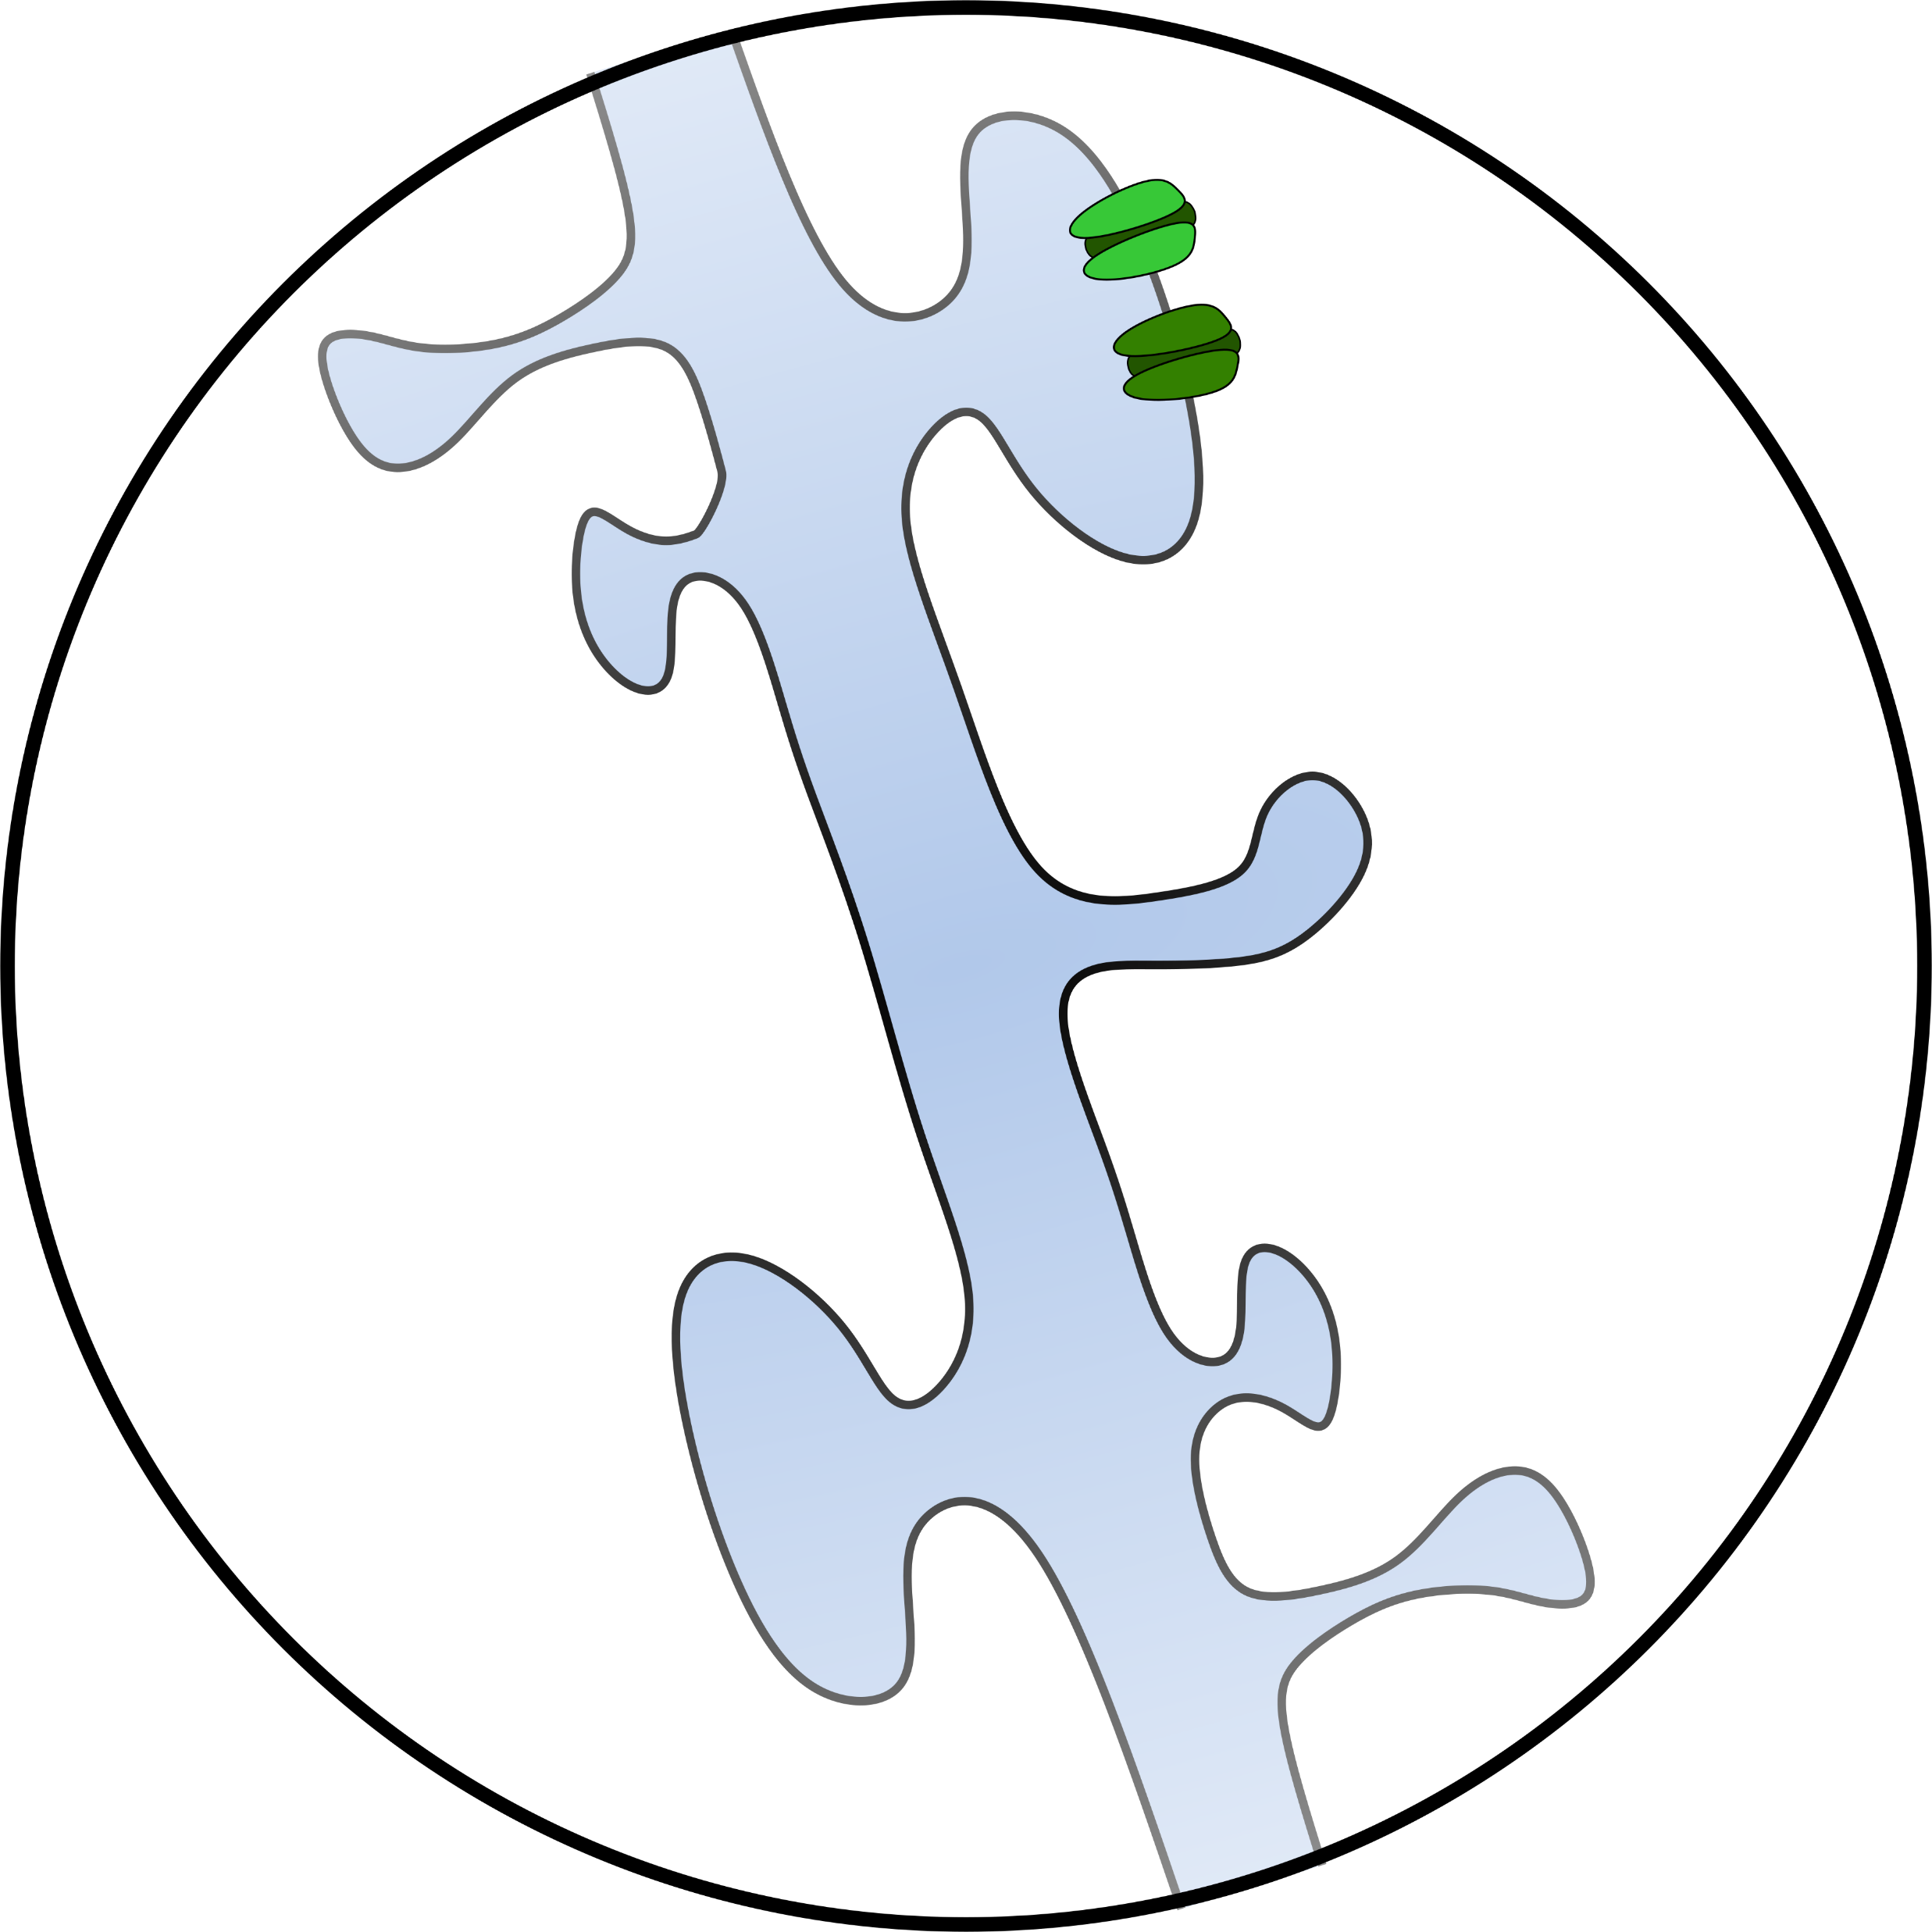
Backpropagating Action Potential (bAP)
Starting from the AIS, a bAP can travel back along the dendrites
  Can amplify PSPs, by promoting dendritic depolarization
  Can promote Ca²⁺ current through NMDAR, by depolarizing the synaptic spines
bAPs can induce Spike Timing-Dependent Plasticity (STDP):
  PSP before bAP → LTP
  bAP before PSP → LTD
  The timing between these two events is essential (+/- 50 ms)
AMPAR
NMDAR
LTP
PSP before bAP
LTD
bAP before PSP
Inter-spike interval (ms)
Synaptic strength (%)

Slide 30
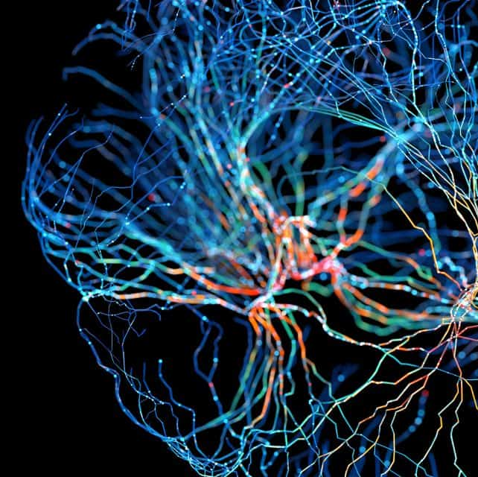
Neuroplasticy in brain systems

Slide 31
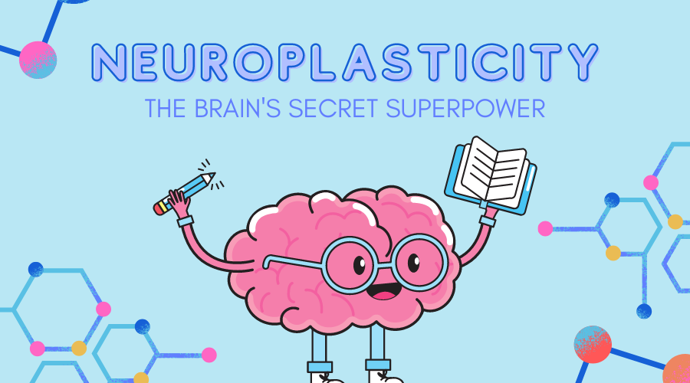
Neuroplasticity
The brain’s capacity to reorganize itself by forming new neural connections in response to changes.

Slide 32
Neuroplasticity
Learning and memory
  Learning a new skill, e.g. play violin
Changing the number of synapses
Refinement of neuronal connections
Adaptation following injury
Maladaptation during disease or chronic stimulation (e.g. pain, substance abuse, neurodegeneration)

Slide 33
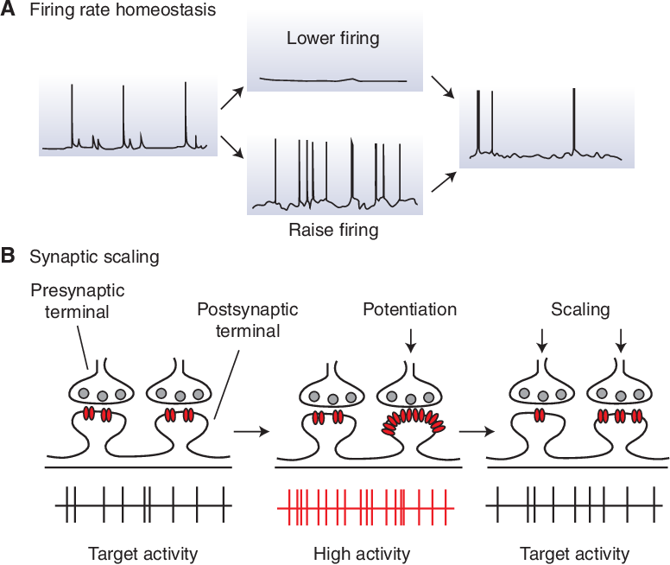
Neuroplasticity
Synapses
  LTP, LTD, STDP
  Synaptic pruning
  Synapse formation
Neurons
  Change in neuronal excitability
  Change in neuronal connections
  Change in neuronal pathways
Homeostatic plasticity
  Keeps network balance
  Affects both synapses and neuronal excitability

Slide 34
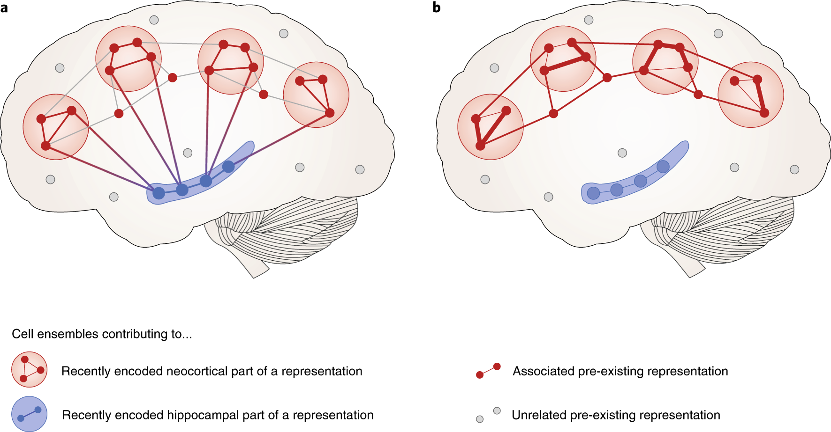
Memory consolidation
Hippocampus and prefrontal cortex
Change in neuronal connection
Passage of memories from hippocampus to the cortex
  Sequential change in synapses and neuronal connections
  Passage to long-term storage and efficient memory retrieval

Slide 35
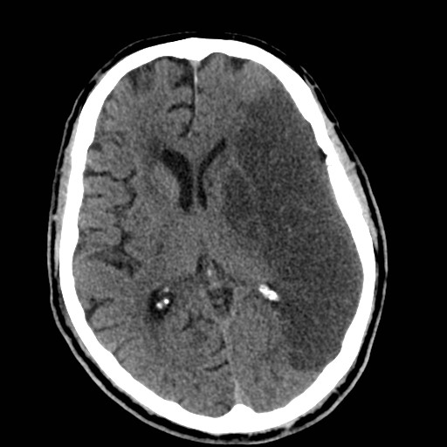
Neuroplasticity in the affected brain

Slide 36
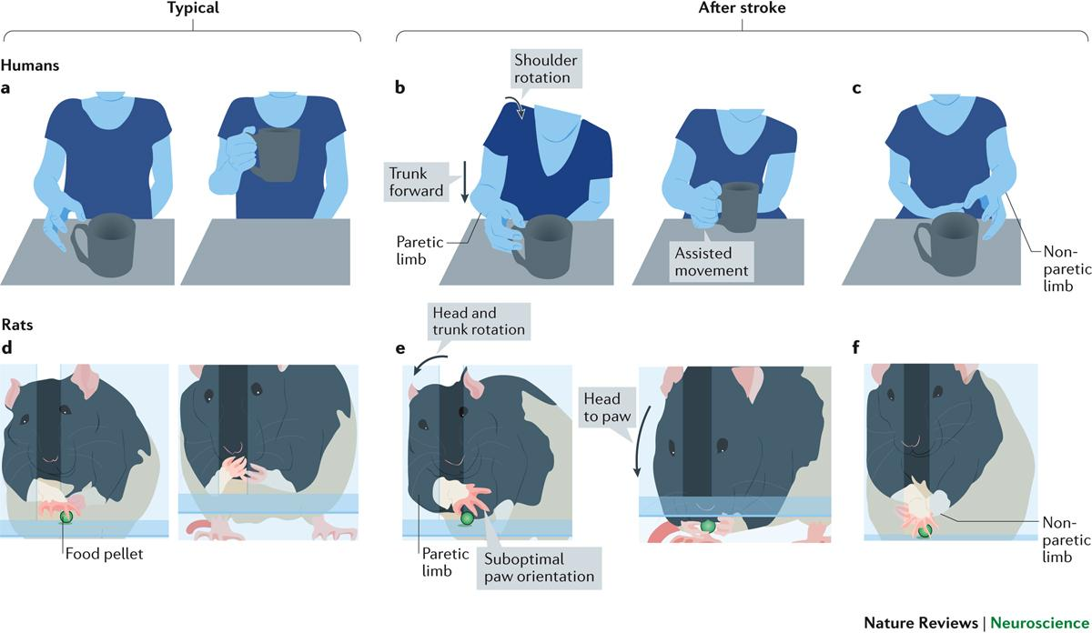
Network compensatory mechanisms
Reallocate lost function to alternative connected brain areas after brain injury
  E.g. non-dominant hemisphere compensates for stroke in dominant hemisphere, regaining partial control of the lost limb
Maladaptive adaptation
  Motor and somatosensory cortices overcompensate missing limb sensory inputs → Phantom limb syndrome
  Synaptic plasticity in overstimulated nociceptive pathways followed by brain-wide network changes → Chronic pain
  Synaptic plasticity in nucleus accumbens and dopamine reward system → Drug addiction

Slide 37
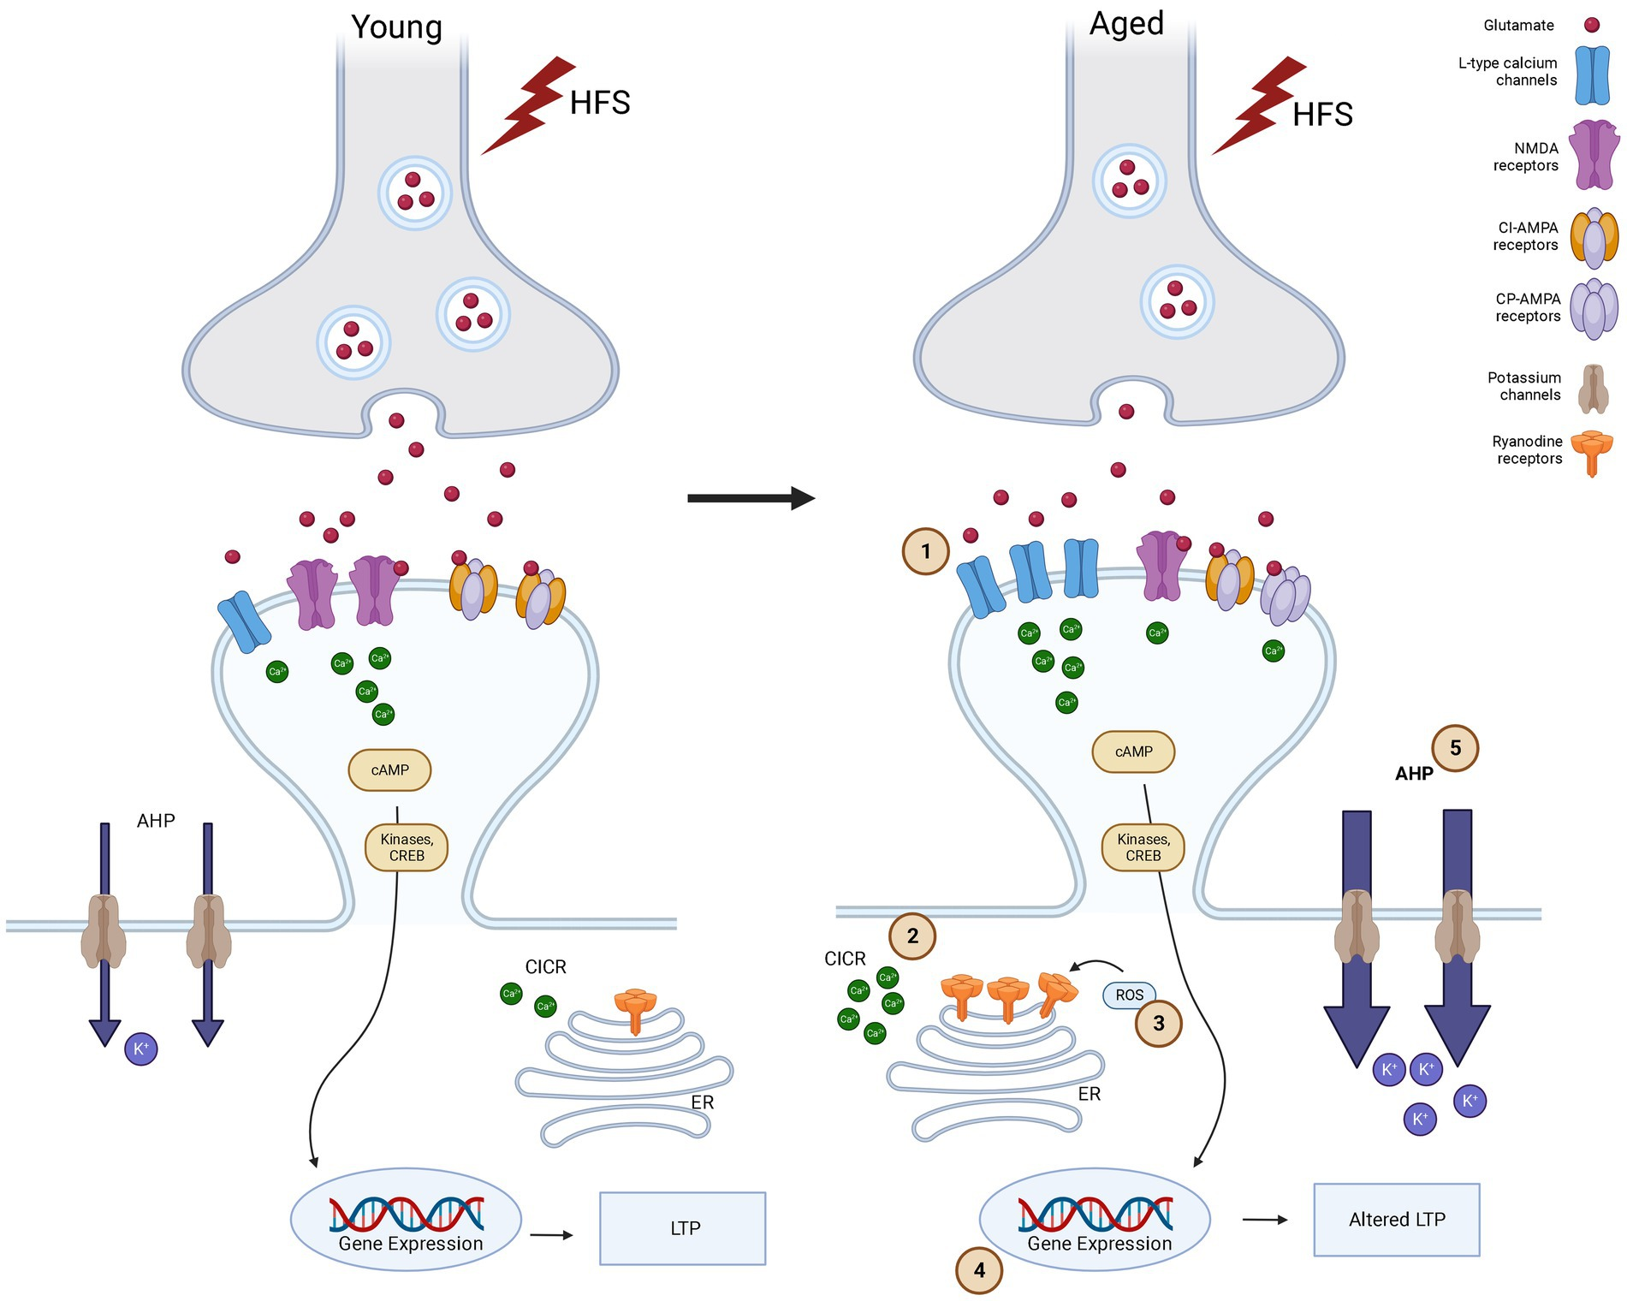
Neuroplasticity and aging
Decline in cognitive performance
  Rapid information processing, decision making, memory, executive cognitive function
  Some functions, such as verbal ability, can remain intact
Some brain areas are more affected
  Hippocampus → episodic memory
Decreased or altered synaptic plasticity
  Also decrease in synapse numbers more than neurons
Increased inflammatory levels in the aging brain

Slide 38
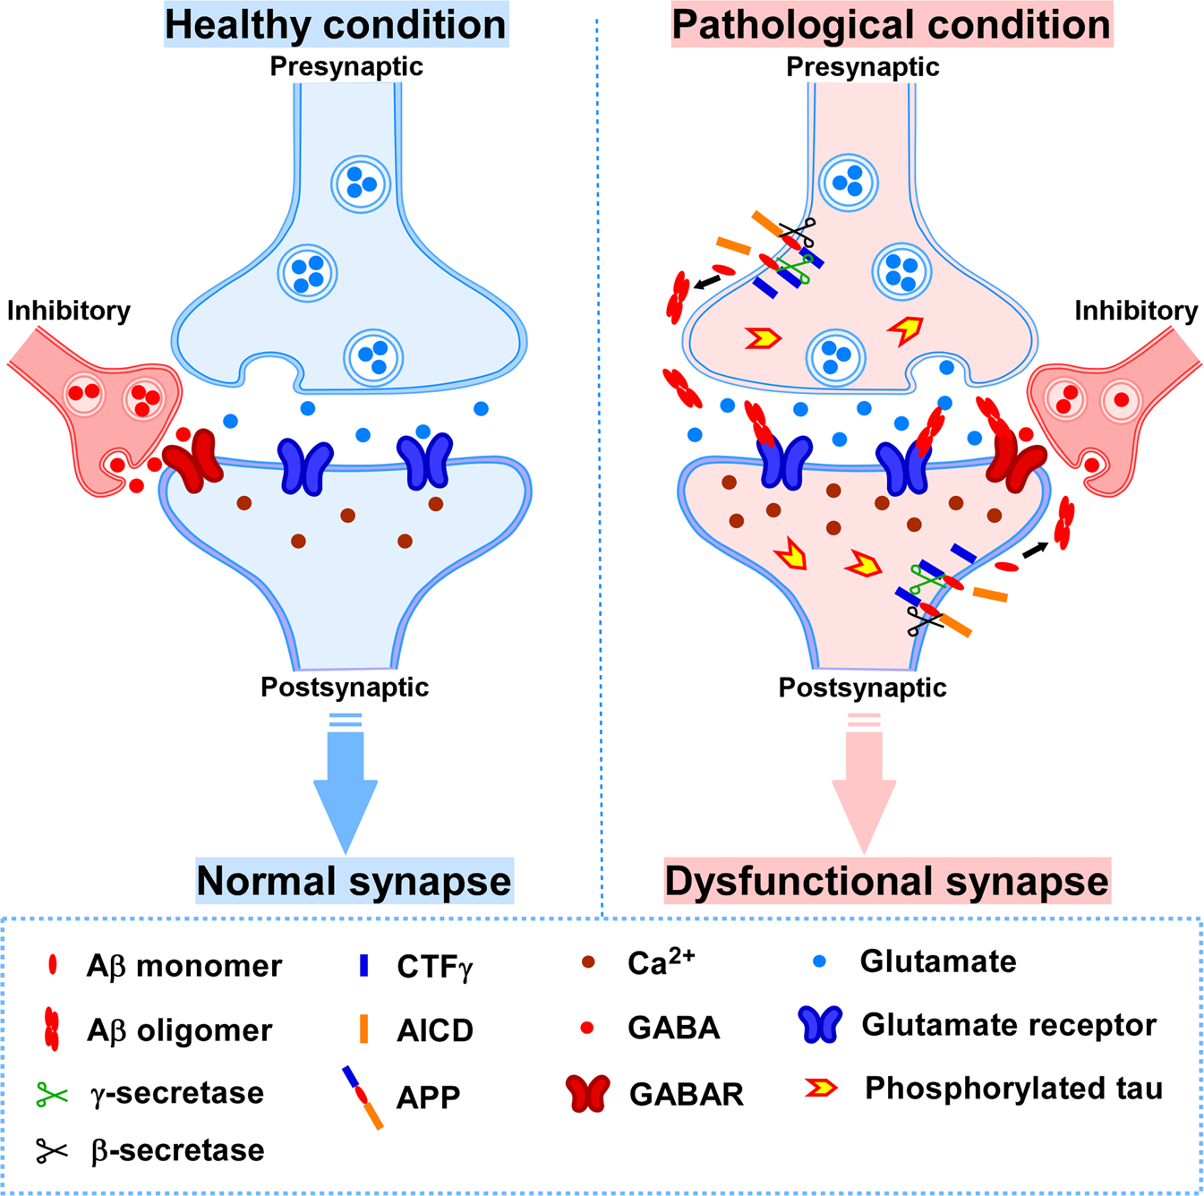
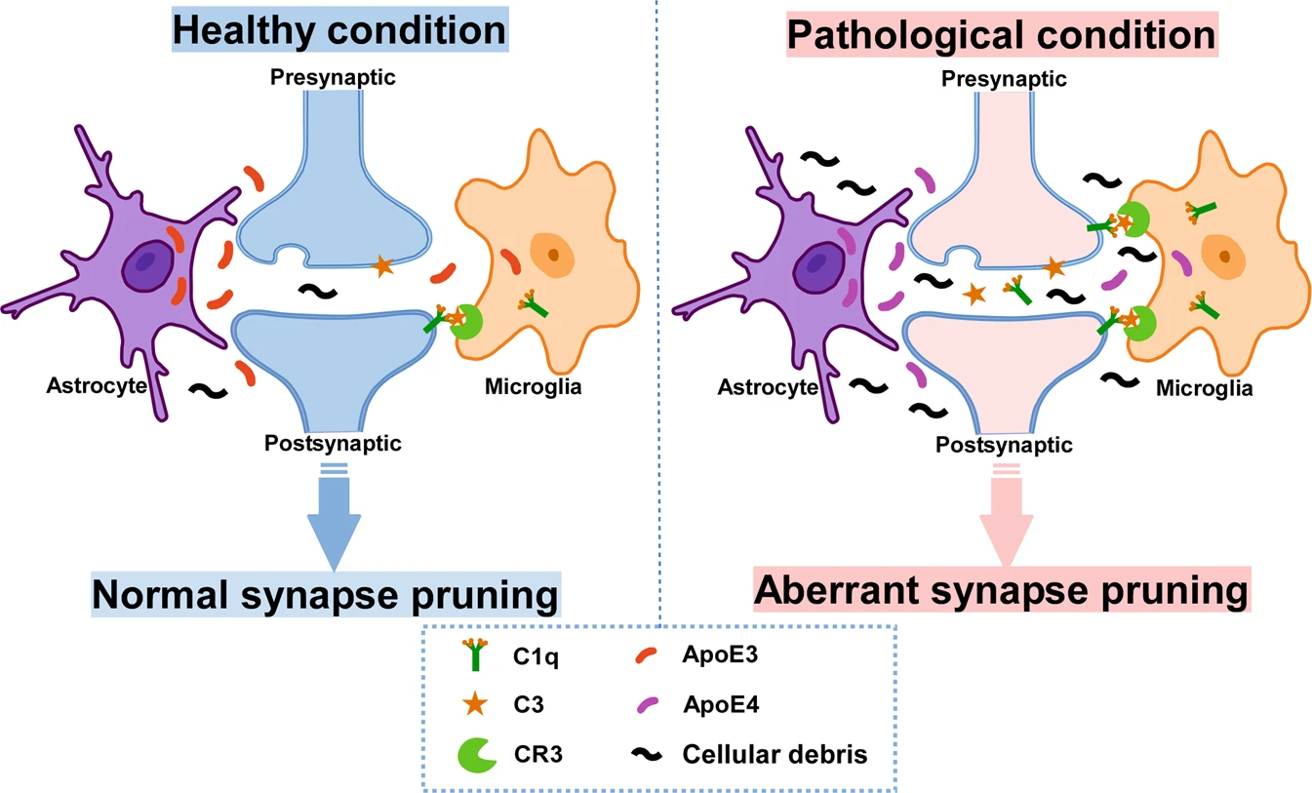
Neuroplasticity and aging
Alzheimer’s Disease (AD) characterized by multiple aspects
  Increased inflammatory presence due to amyloid-β plaques → neuronal death
  Increased synaptic loss and LTD due to oligomeric Aβ

Slide 39
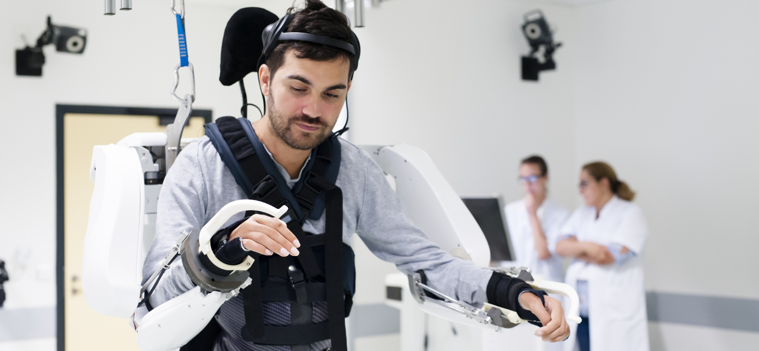
Intervene on neuroplasticity
Brain-computer interfaces (BCIs) to stroke or spinal cord injury patients
  Not only to replace but also to stimulate adaptive neural changes
Trans-cranial magnetic stimulation (TMS) and trans-cranial current stimulation (tDCS)
  Stimulating unused connected brain areas to help compensating affected regions loss
Pharmacological modulation
  Brain-derived Neurotrophic Factor (BDNF)-enhancing drugs, to induce synapse formation and plasticity
  Ion-channels modulators to rebalance neuronal excitability
Cognitive and Behavioural interventions
  Skills training (constraint-induced movement therapy in stroke patients)
  Environment enrichment and mental exercise to slow cognitive decline in aging

Slide 40
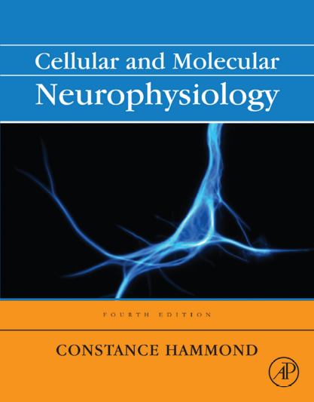


Questions?
For follow-up questions:
vm491@cam.ac.uk
Specific reading:
  Guyton and Hall - Textbook of Medical Physiology 12th ed (2011) ISBN: 978-0-8089-2400-5
  Constance Hammond – Cellular and Molecular Neurophysiology 4th ed (2015) ISBN: 978-0-12-397032-9
  Greg Stuart, Nelson Spruston, Micheal Häusser – Dendrites 3th ed (2016)
  ISBN 978–0–19–874527–3

